Slide 1
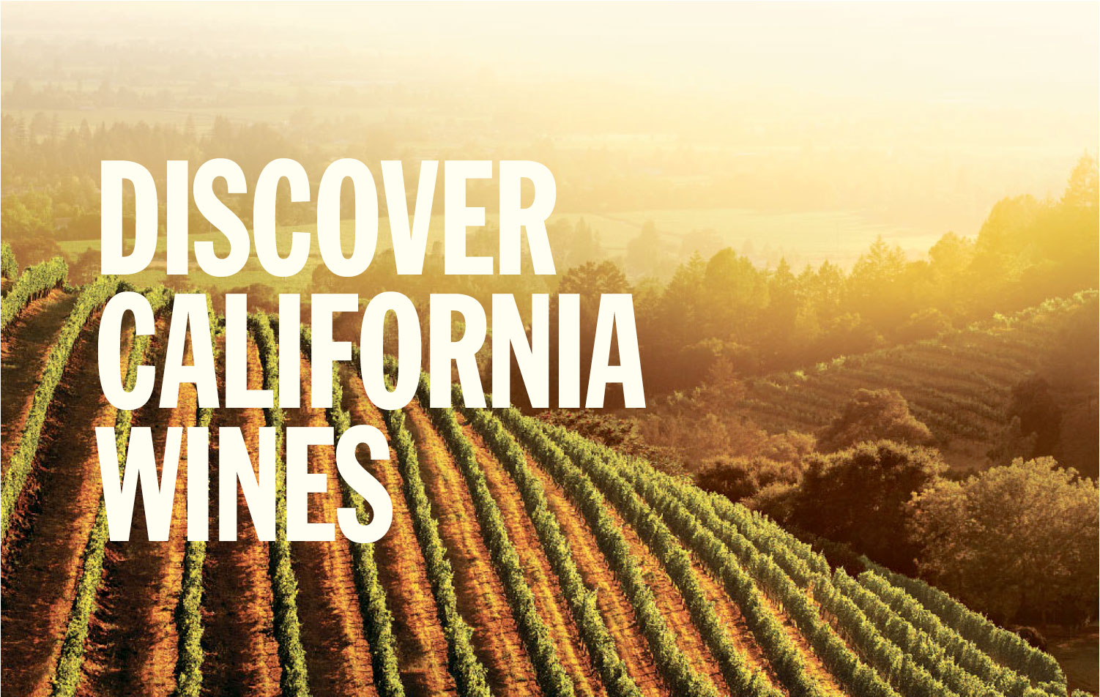
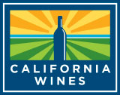
TM
/ PRESENTED BY JANE DOE, Wine Institute Director of International Marketing
May 2017
Notes:
Thank you for being here and welcome to “Discover California Wines”
(INTRODUCE YOURSELF, INCLUDING YOUR TITLE AND YOUR ORGANIZATION NAME)
We represent Wine Institute of California, the non-profit trade association of 1,000 California wineries dedicated to the responsible production, promotion and protection of California wines.
California is America’s top wine producer, accounting for 85 percent of U.S. wine. It is the fourth leading wine producer in the world.
During this presentation, I will share with you information on climate, soils, geography, history, the diverse winegrowing regions, sustainability, food & wine, and examples of attributes which make California unique in the world of wine.
Thank you for your attention and enjoy!

Slide 2
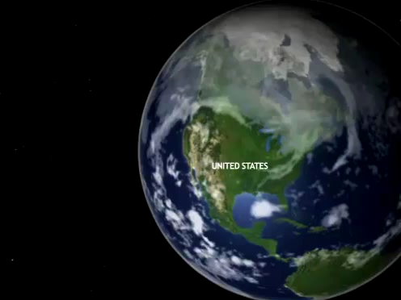
Click to play animation
DiscoverCaliforniaWines.com
Notes:
Here is a satellite animation of California’s coast.
It demonstrates how the ocean air is drawn along the coast, influencing all of our winegrowing regions.
The ocean breezes are drawn far east towards the mountains, cooling our inland valleys and regions such as Sacramento and Lodi.
**(Play animation in slide above)**

Slide 3
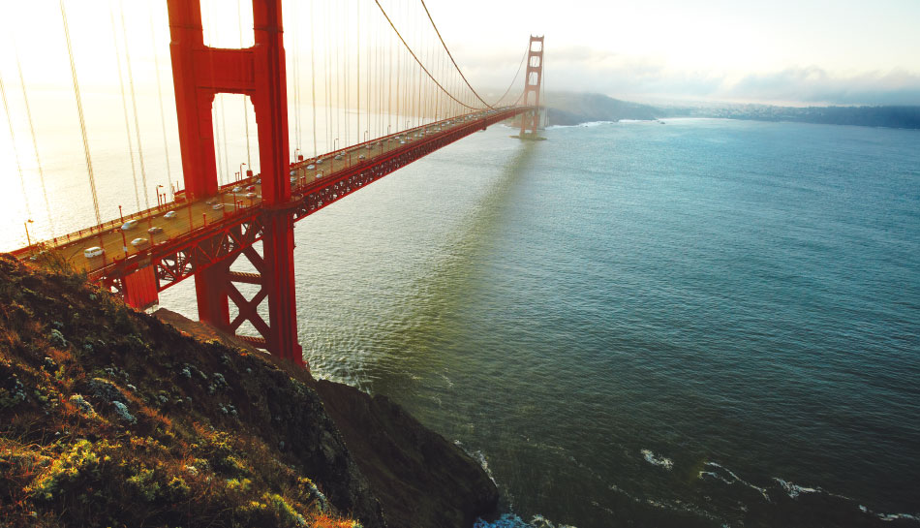
Winegrapes grown in 49 of 58 counties in California
4,700 bonded wineries, most family owned
DiscoverCaliforniaWines.com
Notes:
Grapes are grown throughout the state, in 49 of our 58 counties, making wine truly a statewide industry for California.
The number of wineries in the state, primarily family owned, has more than doubled in the last decade. In 2002 there were 1,700 wineries and there were 4,700 in 2017.
Grapes are one of the top three crops grown in California. The state has over 400 agricultural crops and produces over a third of the country’s vegetables and two-thirds of the fruits and nuts.

Slide 4
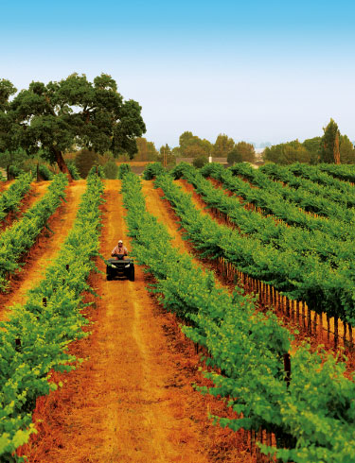
DIVERSE
Landscape
Climate
People
Wines
5,900 winegrape growers
110+ winegrape varieties
DiscoverCaliforniaWines.com
Notes:
California vintners and growers are leaders in combining tradition and innovation.
Our 5,900 winegrape growers work with a diverse landscape, varied climate, and more than 110 winegrape varieties. Our talented growers and vintners have all the natural ingredients to make outstanding wines.
Our multi-generational families, many originally from Italy, Germany and France, have set deep roots in California, and the state continues to attract talent from around the world.

Slide 5
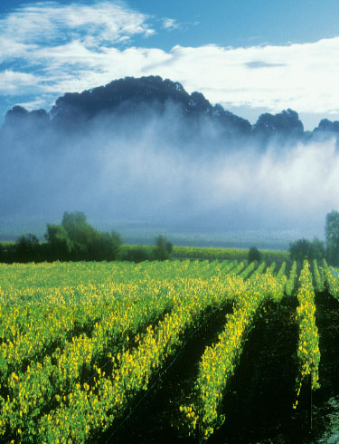
Geography + climate + soil = ideal conditions for
quality grapes
602,000 acres (244,000 hectares) of winegrapes
4.0 million tons (almost
3.6 billion kilograms) of winegrapes harvested in 2016
DiscoverCaliforniaWines.com
Notes:
The geography, climate and soil in California create ideal conditions for quality winegrapes
There are 602,000 acres (244,000 hectares) of winegrapes grown in California
California harvested 4.0 million tons (almost 3.6 billion kilograms) of winegrapes in 2016
Winegrapes are a top crop, but vineyards only cover about one percent of California’s vast terrain.

Slide 6
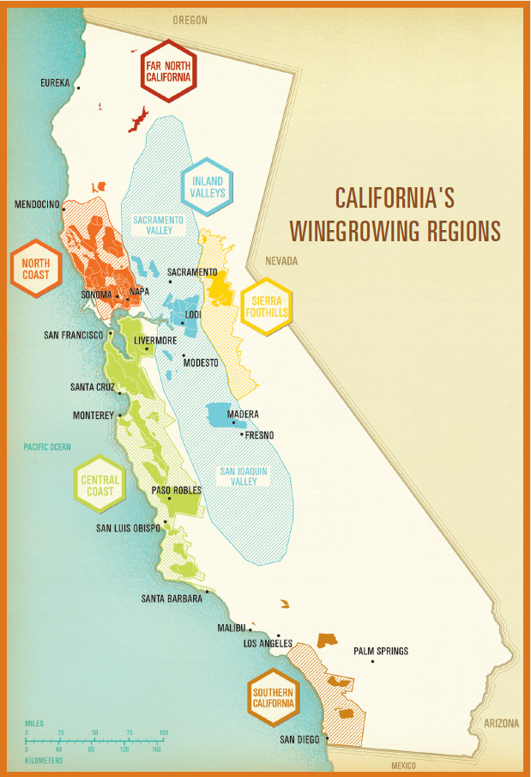
Hundreds of diverse microclimates
138 distinct AVAs
(American Viticultural Areas)
90% of U.S. wine exports come from California
California wines are sold in 138 countries
DiscoverCaliforniaWines.com
Notes:
California has hundreds of diverse microclimates
There are 138 distinct AVAs (American Viticultural Areas)
90% of U.S. wine exports come from California
California wines are sold in 138 countries

Slide 7
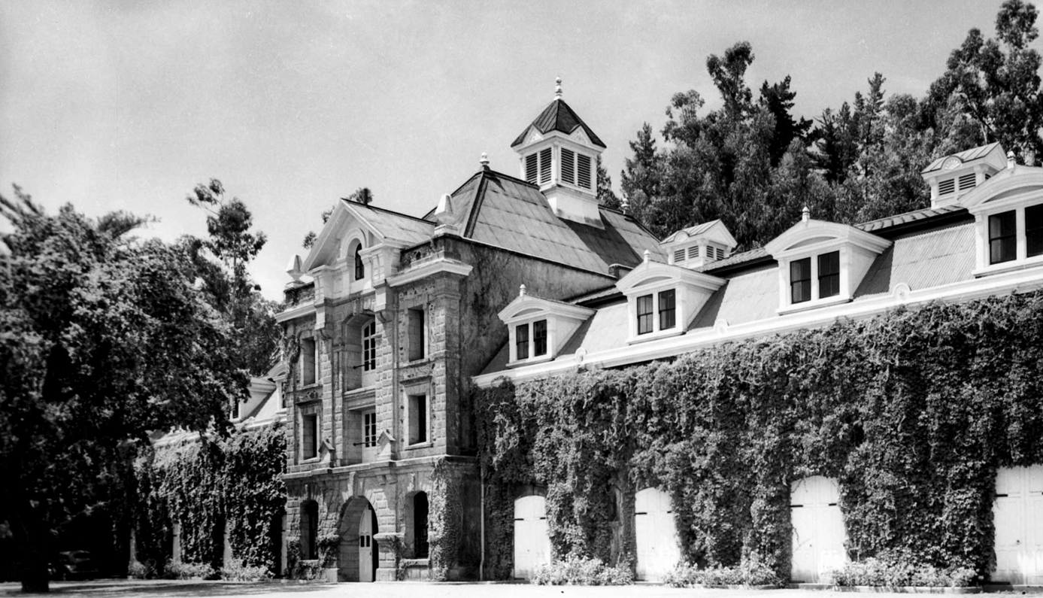
Inglenook Vineyards
DiscoverCaliforniaWines.com
Notes:
Now we would like to present an overview of California’s 250 year winegrowing history.
Here is a photo of the historic Inglenook Vineyards, one of the pioneering wineries in Napa Valley, and still in operation today.

Slide 8
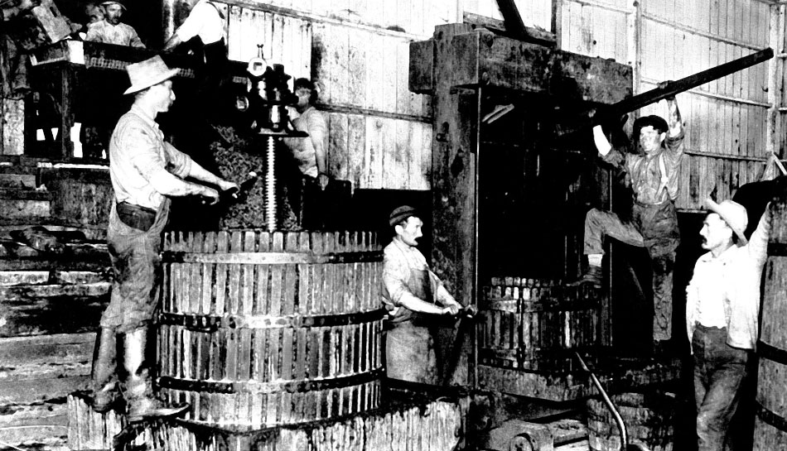
1850: 210,000 9-liter cases produced in California
DiscoverCaliforniaWines.com
Notes:
Back in 1850, California produced 210,000 nine-liter cases of wine.

Slide 9
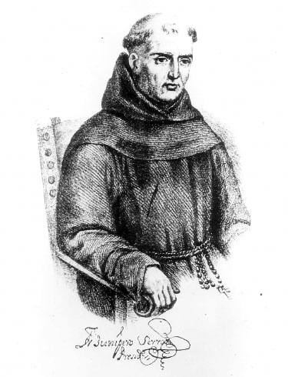
1769
First wine grapes in California planted by Franciscan missionary Father Junipero Serra at Mission San Diego de Alcala
1771
The oldest winery in California, Mission San Gabriel, is founded near Los Angeles
1833
First imported vines from Europe brought in by California's first commercial winegrower, Jean-Louis Vignes, to Los Angeles area
DiscoverCaliforniaWines.com
Notes:
California’s first wines were produced by the Spanish missionaries who were making wines for religious services.
The chain of 21 missions stretched from San Diego to Sonoma along the coast, nearly all of which grew grapes and made wine.
The first imported winegrapes were brought to California in 1833 and planted in southern California.

Slide 10
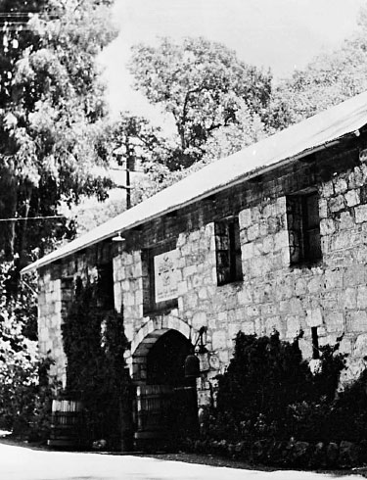
1834
When Mexican government abandons the Sonoma Mission, General Mariano Vallejo takes over its vineyard, expands it and becomes Sonoma's first commercial winegrower
1838
Explorer George Calvert Yount plants first vines in Napa Valley in Yountville
Buena Vista Winery
DiscoverCaliforniaWines.com
Notes:
In the 1830s, both Sonoma and Napa Valley first became winegrowing regions.

Slide 11
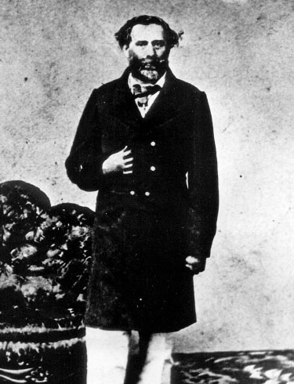
1857
Agoston Haraszthy founds Buena Vista Winery, California’s first commercial winery, in Sonoma
1856 - 1858
After the Gold Rush, plantings vastly expand in California from 1.5 million vines to nearly 4 million vines in two years
Agoston Haraszthy
1861
Charles Krug founds Napa Valley’s first commercial winery
DiscoverCaliforniaWines.com
Notes:
The gold rush represented the start of a period of vineyard expansion throughout California, as the state’s population expanded.
The first commercial wineries were established during that period.
In 1857, Agoston Haraszthy founded Buena Vista Winery, California’s first commercial winery, in Sonoma
1856-1858: after the Gold Rush, plantings vastly expanded in California, from 1.5 million vines to nearly 4 million vines in two years
In 1861, Charles Krug founded Napa Valley’s first commercial winery

Slide 12

1900
American wine industry prospers with wines exported around the world
1919
Prohibition in the U.S. outlaws the commercial production of wine – California wine production drops 94%
1933
Prohibition is repealed
DiscoverCaliforniaWines.com
Notes:
The American wine industry was thriving in the early 1900s, but Prohibition, which outlawed the commercial production of alcoholic beverages and lasted from 1919 to 1933, was a huge setback and nearly wiped out the commercial wine industry in California and the rest of the U.S. Some wineries survived by supplying grapes for home winemakers and religious services.
1900 – the American wine industry prospered with wines exported around the world
1919 - Prohibition in the U.S. outlawed the commercial production of wine – California wine production dropped 94%
1933 – Prohibition was repealed

Slide 13
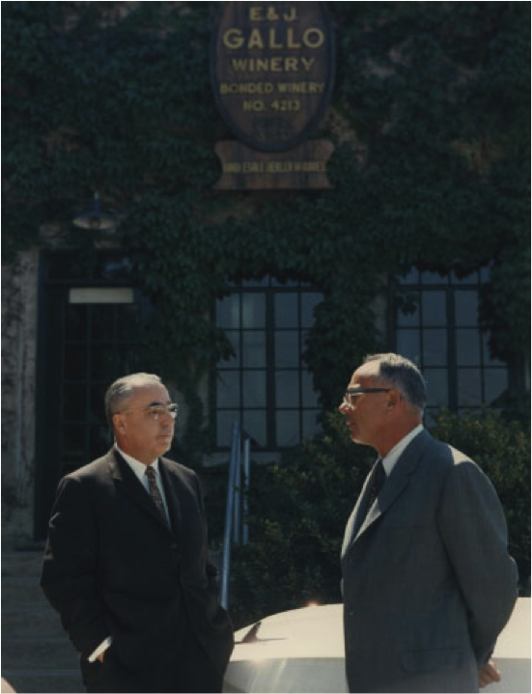
1933
Ernest and Julio Gallo start E. & J. Gallo Winery in Modesto; today it is the largest winery in the world
1934
Wine Institute of California established
1935
University of California at Berkeley and Davis lead viticulture and winemaking research and education
DiscoverCaliforniaWines.com
Notes:
Following the repeal of prohibition in 1933, new wineries were started, Wine Institute was established and academic institutions began research and education to help re-build the California wine industry.
1933 - Ernest and Julio Gallo start E. & J. Gallo Winery in Modesto; today it is the largest winery in the world
1934 – Wine Institute of California is established
1935 – University of California at Berkeley and Davis lead viticulture and winemaking research and education as the industry rebuilds itself following prohibition

Slide 14
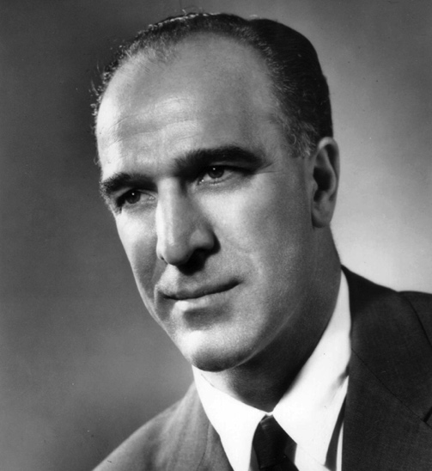

1960s / 70s
Many winemakers & winegrape growers see the great potential in California and start wineries
1966
Robert Mondavi establishes his winery in Napa Valley, the first major winery there since Prohibition
1976
Judgment of Paris blind tasting, reported in Time Magazine, changes international perceptions of California wine when French judges select California wines as three of top four Chardonnays, and top red
DiscoverCaliforniaWines.com
Notes:
The 1960s and 1970s saw a surge of vineyard plantings and winery start ups in the Golden State.
The famous Judgment of Paris tasting firmly put California on the map of fine wine producers.
1960s/70s: Many winemakers & winegrape growers saw the great potential in California and started wineries
1966: Robert Mondavi established his winery in Napa Valley, the first major winery there since Prohibition
1976: Judgment of Paris blind tasting, reported in Time Magazine, changed international perceptions of California wine when French judges selected California wines as three of top four Chardonnays, and top red

Slide 15
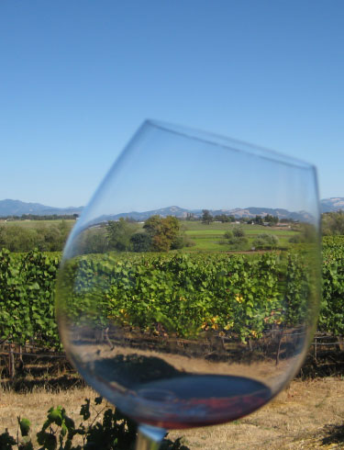
1980
Winegrapes are planted in more than half of California’s 58 counties; today they are grown in 49 counties
1991
More than 50 American Viticultural Areas – distinct growing areas approved by the U.S. government – are established in California; today there are 138
1997
The number of wineries in California grows to more than 1,000; today there are 4,700
DiscoverCaliforniaWines.com
Notes:
In the 1980s and 1990s, winegrowing spread throughout the state, and the first American Viticultural Areas or AVAs were established.
1980: Winegrapes are planted in more than half of California’s 58 counties; today they are grown in 49 counties
1991: More than 50 American Viticultural Areas – distinct growing areas approved by the U.S. government – are established in California; today there are 138
1997: The number of wineries in California grows to more than 1,000; today there are 4,700

Slide 16
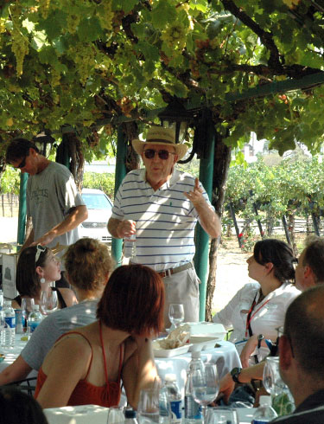
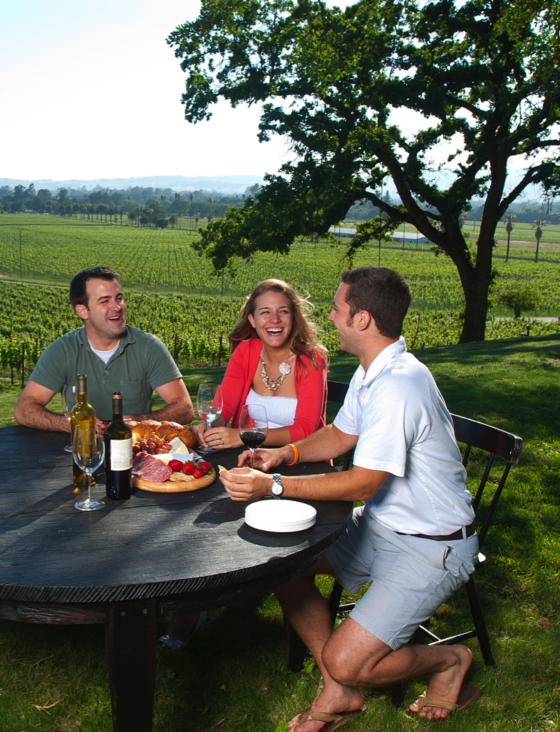
2002
Wine Institute vintners and California growers introduce the Code of Sustainable Winegrowing, covering more than 200 best practices for the vineyard, winery and community.
2005
21 million visitors each year are welcomed at many of the 4,100 wineries throughout the state
DiscoverCaliforniaWines.com
Notes:
California is famous for its commitment to environmental stewardship and its wine country hospitality.
2002: Wine Institute vintners and California growers introduce the Code of Sustainable Winegrowing, covering more than 200 best practices for the vineyard, winery and community.
2005: 21 million visitors each year are welcomed at many of the 4,100 wineries throughout the state

Slide 17

2008
U.S. wine exports, 90 percent from California, surpass $1 billion
2010
The U.S. becomes the world’s No. 1 wine consuming nation
TODAY
California is now the world’s fourth largest wine producer, and its wines are enjoyed around the world as their reputation for excellence continues to grow
DiscoverCaliforniaWines.com
Notes:
California is now the world’s biggest wine consuming nation and its exports continue to grow around the world.
2008: U.S. wine exports, 90 percent from California, surpass $1 billion
2010: The U.S. becomes the world’s No. 1 wine consuming nation
TODAY: California is now the world’s fourth largest wine producer, and its wines are enjoyed around the world as their reputation for excellence continues to grow

Slide 18
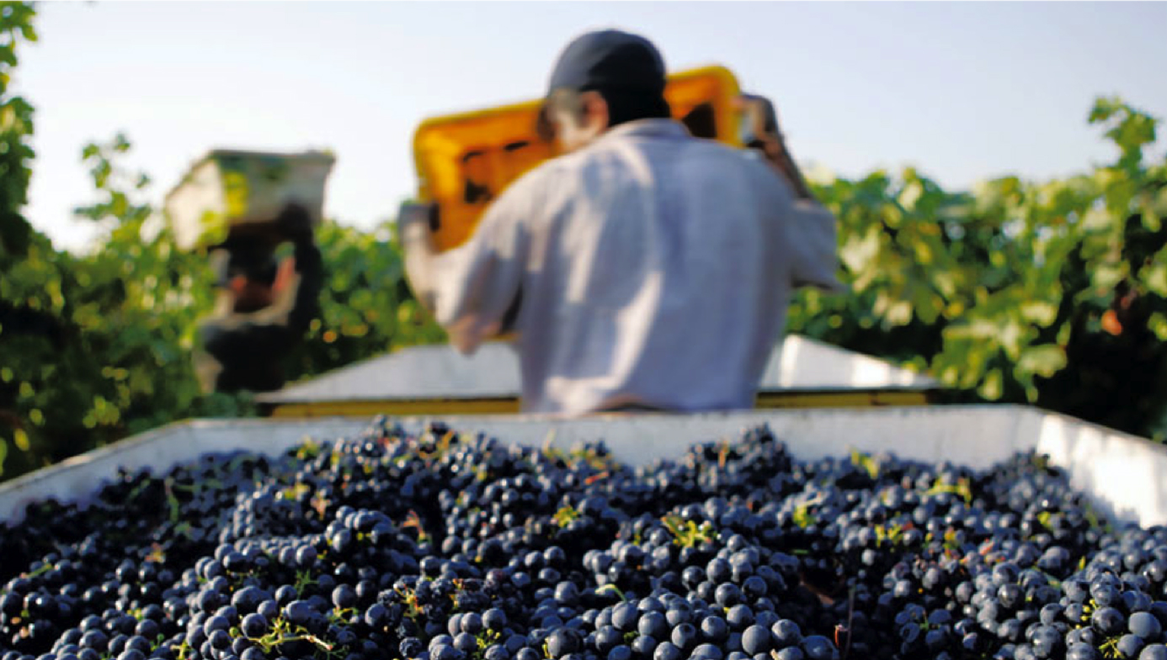
2016: 285,000,000 9-liter cases produced in California
DiscoverCaliforniaWines.com
Notes:
In 2016, California produced 285 million 9-liter cases of wine.

Slide 19

Unparalleled scenic beauty
California’s diverse geography, climate and soil variety are at the heart of our offering of world-renowned wines
DiscoverCaliforniaWines.com
Notes:
California’s diverse geography, climate and soil are all key factors in our world-renowned wines.

Slide 20
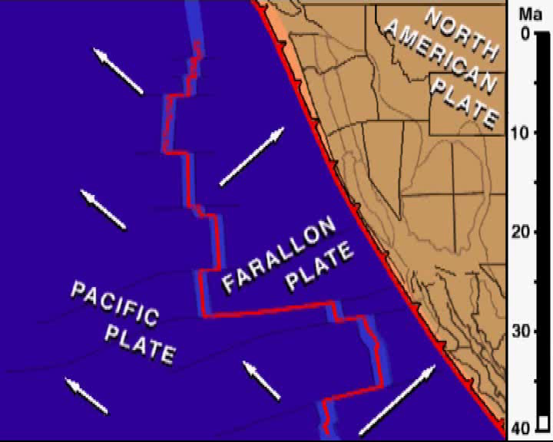
/ FORMING CALIFORNIA
Click to play animation
DiscoverCaliforniaWines.com
Notes:
A geologically complex and active area of the world, California’s topography was formed by the shifting of deep underground plates which formed 2 long mountain ranges and deep, fertile valleys.
**(Play animation in slide above)**

Slide 21
/ GOLDEN STATE GEOGRAPHY
800 miles (1,300 km) of coastline
Cool ocean air is drawn inland to warmer valleys, creating California’s famous coastal fog
Marine breezes and fog create the ideal combination of warm days and cool nights in California vineyards
DiscoverCaliforniaWines.com
Notes:
The long California coastline and the influence of the Pacific Ocean create the conditions for producing high quality grapes and wine
California has 800 miles (1,300 km) of coastline – one of the longest coastlines in the world adjacent to a winegrowing region.
Cool ocean air is drawn inland to warmer valleys creating California’s famous coastal fog.
Marine breezes and fog create the ideal combination of warm days and cool nights for growing grapes.
The marine influence extends California’s growing season to allow deeper color, flavor and optimum maturity.

Slide 22

/ CALIFORNIA GEOGRAPHY
DiscoverCaliforniaWines.com
Notes:
California’s geography is diverse with mountains, valleys, coast, desert and high elevations.
Our coastal mountain ranges help protect California’s winegrowing regions and ensure consistent growing conditions year after year.
The diverse geography that is so great for grapes is also great for outdoor recreation: relaxed beach lifestyle, dramatic desert landscapes, spectacular mountains for skiing, hiking and camping.

Slide 23
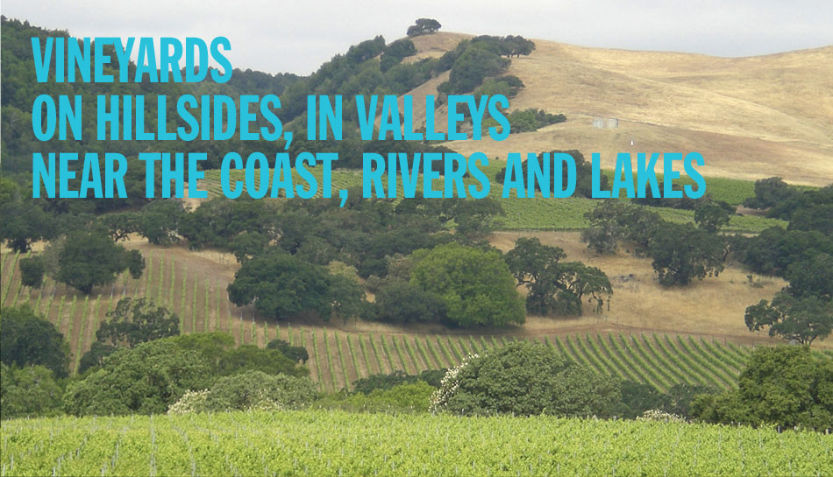
/ CALIFORNIA GEOGRAPHY
138 American Viticultural Areas (AVAs)
DiscoverCaliforniaWines.com
Notes:
Vineyards thrive on hillsides, in valleys, near the coast, rivers and lakes.
California has 138 American Viticultural Areas (AVAs), U.S. government approved winegrowing areas. AVAs have unique geographical features, climate and history.

Slide 24
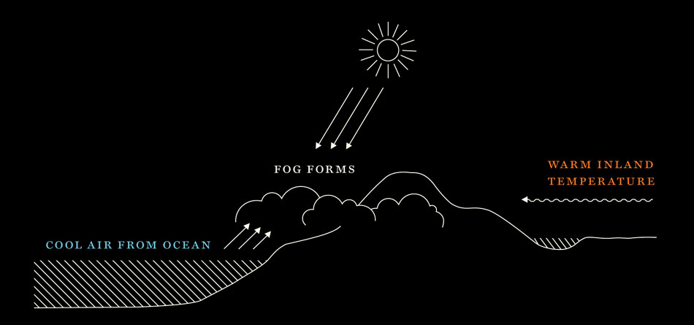
/ CALIFORNIA CLIMATE
Unparalleled scenic beauty
Warm days, cool nights
Ideal conditions for winegrape growing
Warm days ripen the grapes, cool nights regulate the fruit maturation
DiscoverCaliforniaWines.com
Notes:
This slide illustrates how the cool air from the ocean intersects with warm inland air to create California’s signature fog.
California’s warm days and cool nights are the ideal conditions for winegrape growing. Warm days ripen the grapes and cool nights regulate the fruit maturation.

Slide 25

/ CALIFORNIA CLIMATE
Unparalleled scenic beauty
Cool Ocean Air →
Warm Inland Air ←
Click to play animation
As a result of California’s long coastline & varied topography:
- Abundant sunshine + maritime influence
- Hot + Cold air create fog
DiscoverCaliforniaWines.com
Notes:
As a result of California’s long coastline and varied topography, we have abundant sunshine and maritime influence. Warm inland air, represented by the orange shape, and cool coastal air, represented by the blue shape meet and create fog.
California enjoys an ideally long, consistent and dry growing season, which generally starts with bud break in March and concludes with harvest, which can last through November.
**(Play animation in slide above)**

Slide 26

/ CALIFORNIA SOILS
Unparalleled scenic beauty
The formation of California created a large diversity of 2,800 soil types, among them:
Sand
Clay
Loam
Granite
Volcanic ash
Seabed soil
River-run gravel
Click to play animation
DiscoverCaliforniaWines.com
Notes:
The geological formation of California created a large diversity of soil types, among them sand, clay, loam, granite, volcanic ash, seabed soil, and river-bed gravel
There are more than 2,800 soil types in California

Slide 27
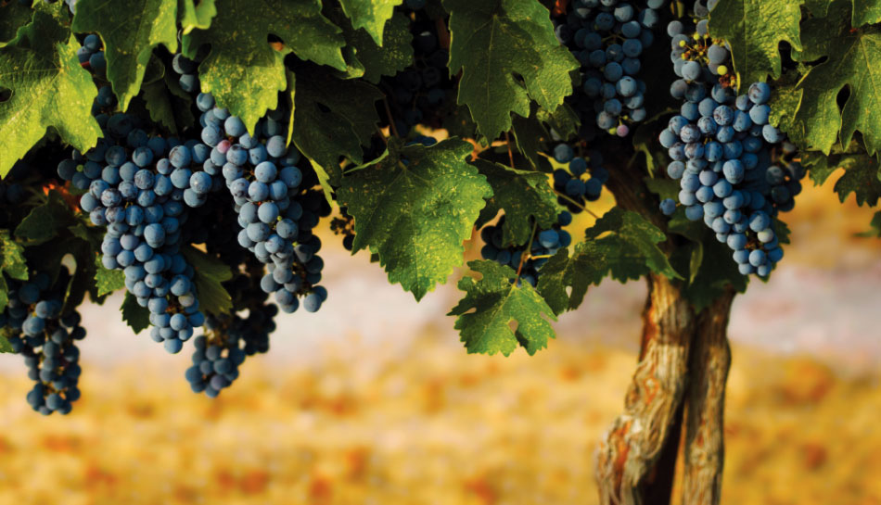
Vineyards
cover 602,000 acres (244,000 hectares), about 1% of
California’s terrain
DiscoverCaliforniaWines.com
Notes:
Winegrape vineyards cover 602,000 acres (244,000 hectares), about 1% of California’s total land

Slide 28
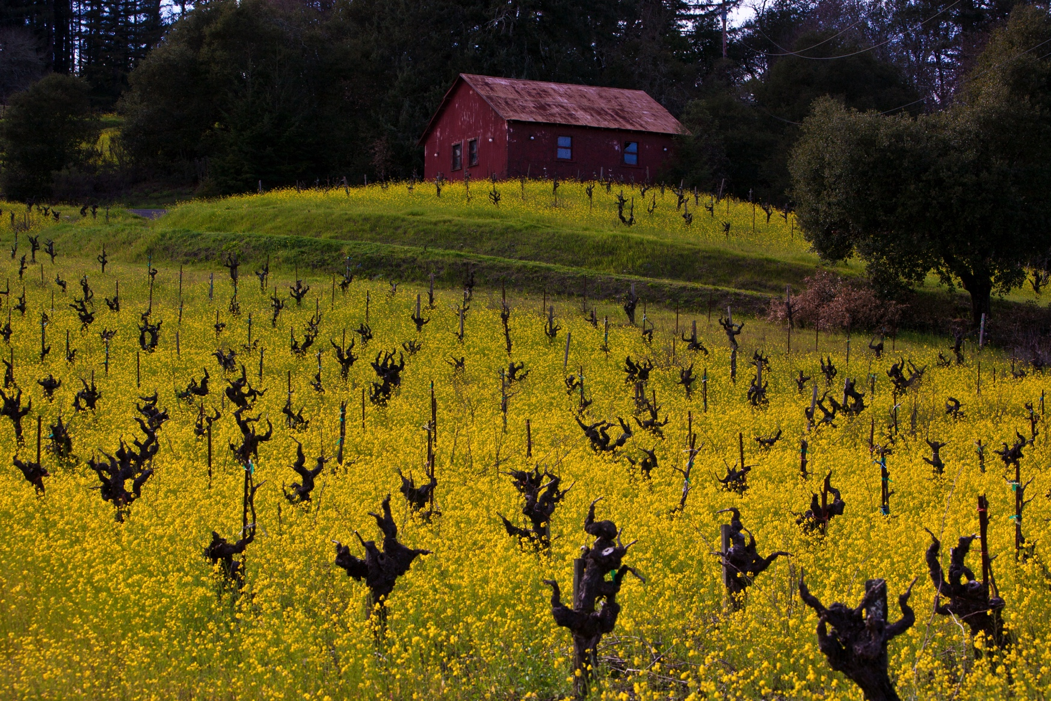
Unparalleled scenic beauty
DiscoverCaliforniaWines.com
Notes:
Wine is grown throughout California, in 49 of our 58 counties.
California is comprised of six macro winegrowing regions: North Coast, Central Coast, Southern California, Inland Valleys, Sierra Foothills and Far North.

Slide 29
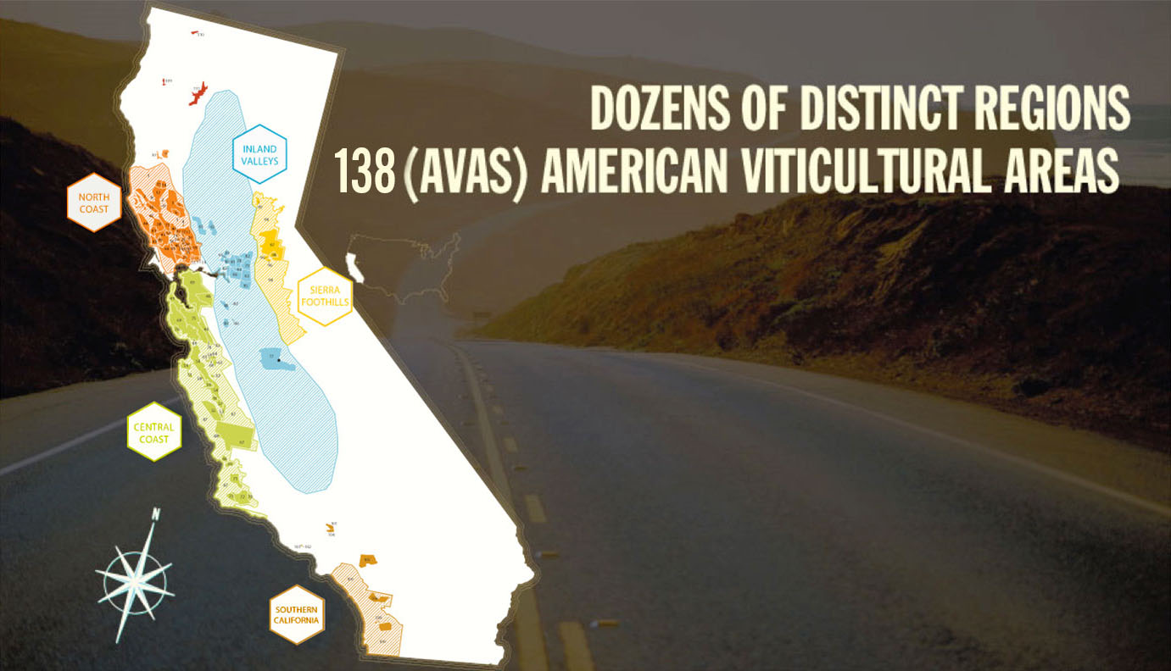
Unparalleled scenic beauty
What is an AVA?
American Viticultural Area:
A U.S. government recognized
winegrowing region
DiscoverCaliforniaWines.com
Notes:
There are dozens of distinct winegrowing regions in California, with 138 AVAs, which are U.S. government recognized winegrowing regions.
Wine labels can show either an AVA or the name of a county or state as the appellation.

Slide 30
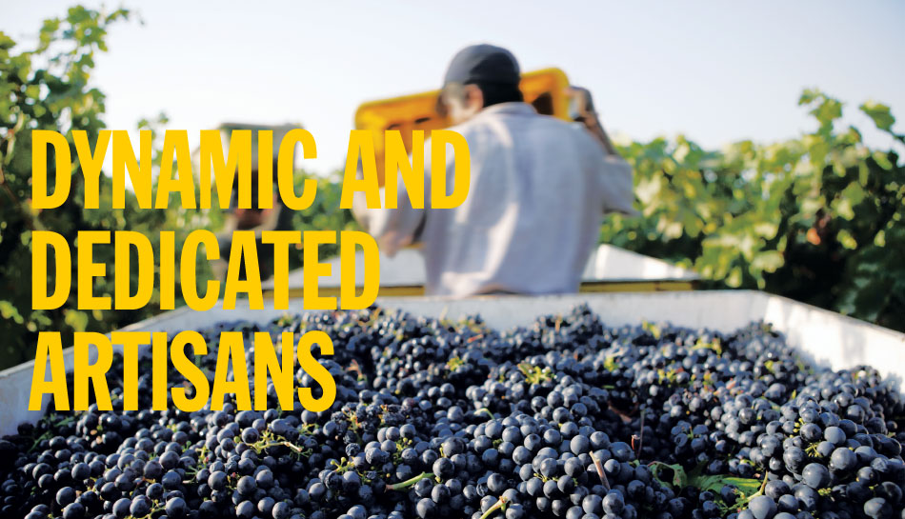
Winemakers and growers – catalysts for a worldwide revolution in wine quality
Families with long-term commitment producing great wines at every price point.
DiscoverCaliforniaWines.com
Notes:
The majority of California’s wineries are family owned, often multi-generational businesses.
We combine the best of tradition with a spirit of innovation.
California’s winemakers are dynamic and dedicated artisans. Our winemakers and growers have been catalysts for a worldwide revolution in wine.
Our winemaking families have a long-term commitment to producing great wines at every price point.

Slide 31
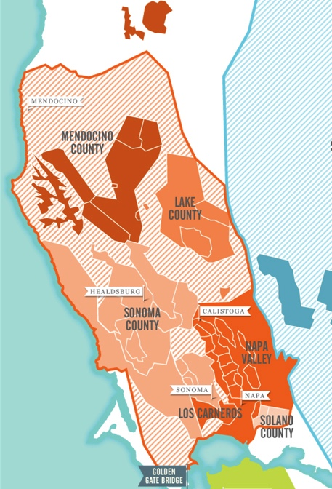
/ NORTH COAST
North Coast (54 AVAs)
One of the coolest climates in the state
Home to more than half of California’s wineries
The scenery along the North Coast is as memorable as the wine
DiscoverCaliforniaWines.com
Notes:
Some of the North Coast’s best known regions include: Lake County, Los Carneros, Mendocino County, Napa Valley and Sonoma County
California’s North Coast has 54 AVAs.
It is home to more than half of California’s wineries
The scenery along the North Coast is as memorable as the wine, with beaches, dramatic seaside cliffs, towering redwoods, and rolling hills dotted with oak trees which are all part of the scenic pastoral landscape.

Slide 32
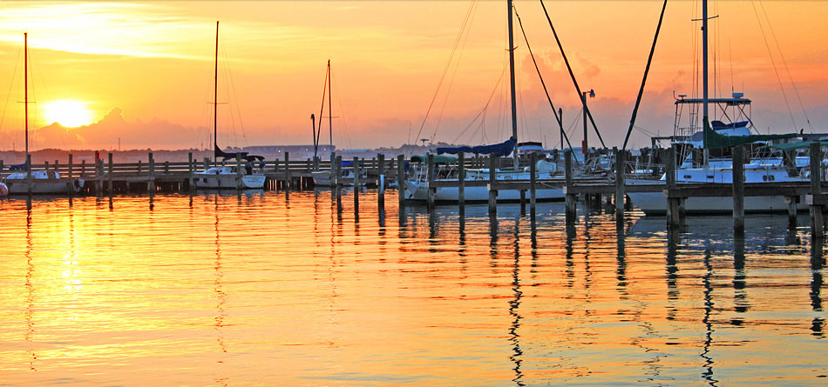
/ NORTH COAST
LAKE COUNTY − Clear Lake, the largest natural fresh water lake in the state, is the jewel of Lake County
DiscoverCaliforniaWines.com
Notes:
Lake County is an expanding winegrowing region of the state that is built around Clear Lake, the largest natural fresh water lake in California.

Slide 33
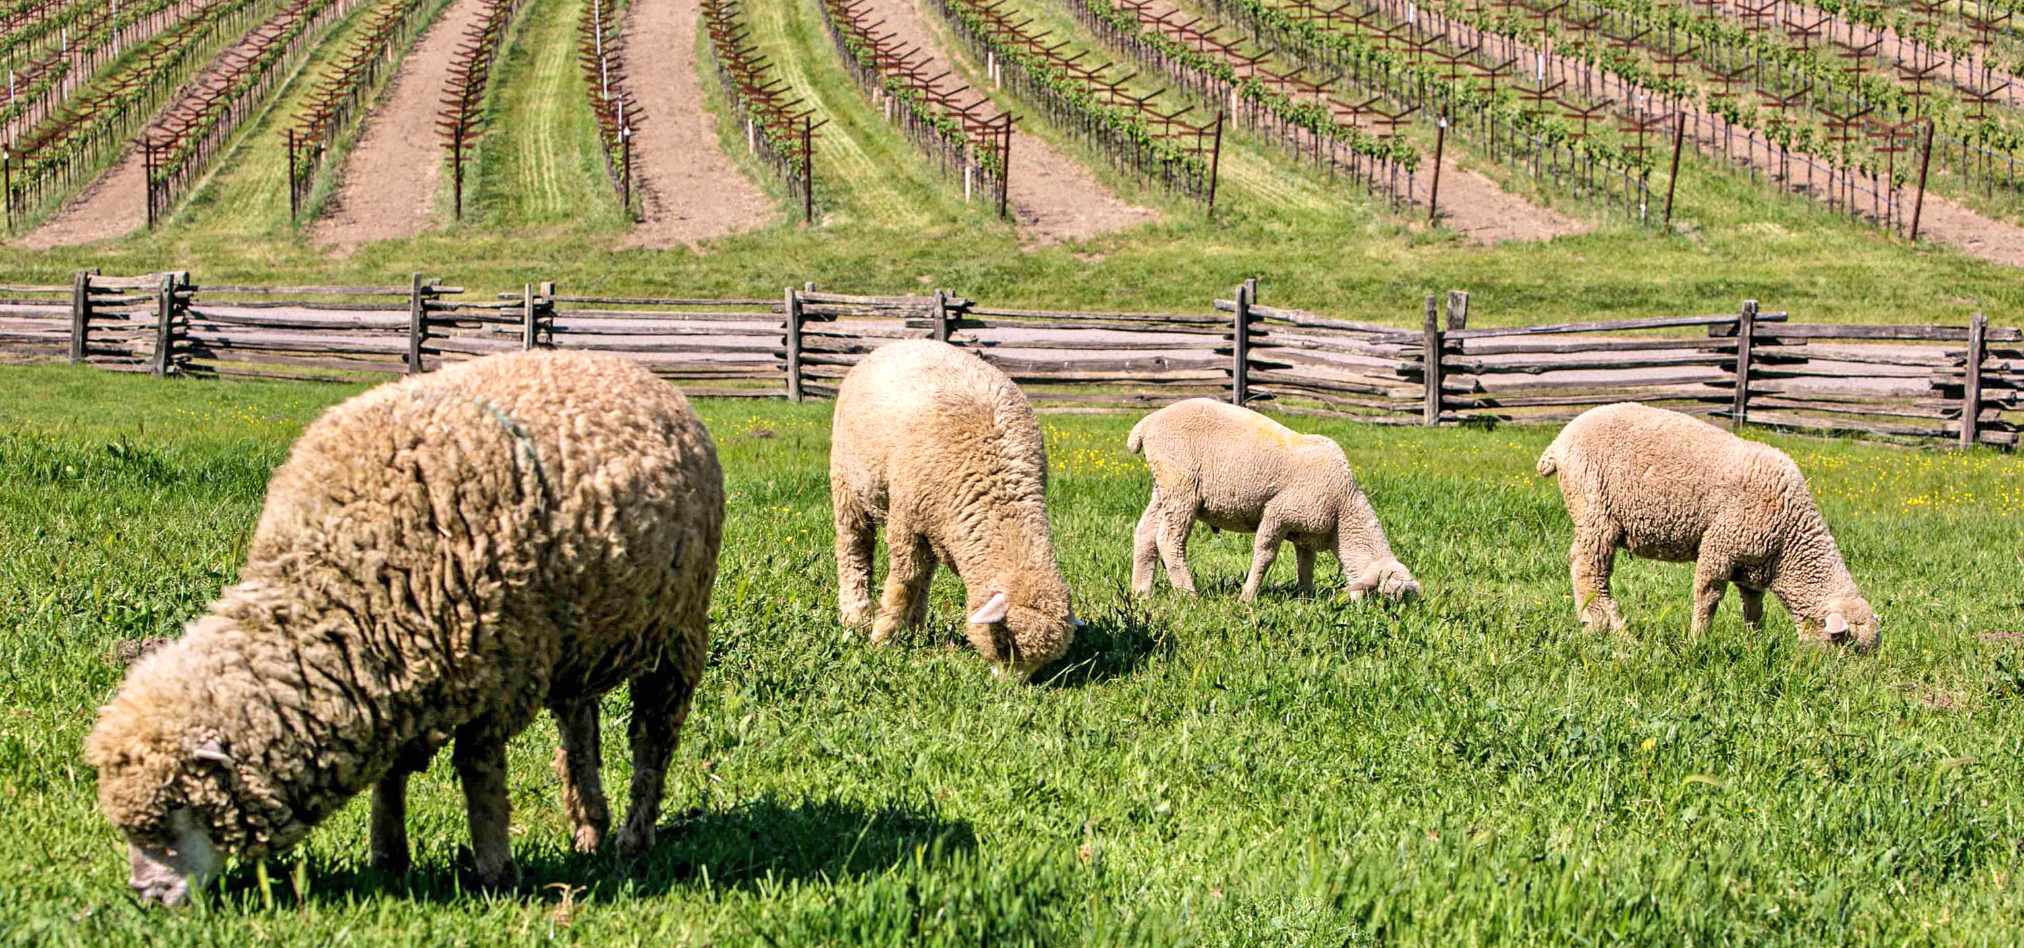
/ NORTH COAST
LOS CARNEROS – Straddles Napa and Sonoma counties and celebrated for its sparkling wine and Pinot Noir
DiscoverCaliforniaWines.com
Notes:
Los Carneros is a cool winegrowing region, influenced by breezes from the San Pablo Bay. It straddles Napa and Sonoma counties and is celebrated for its sparkling wine, Pinot Noir and Chardonnay.

Slide 34
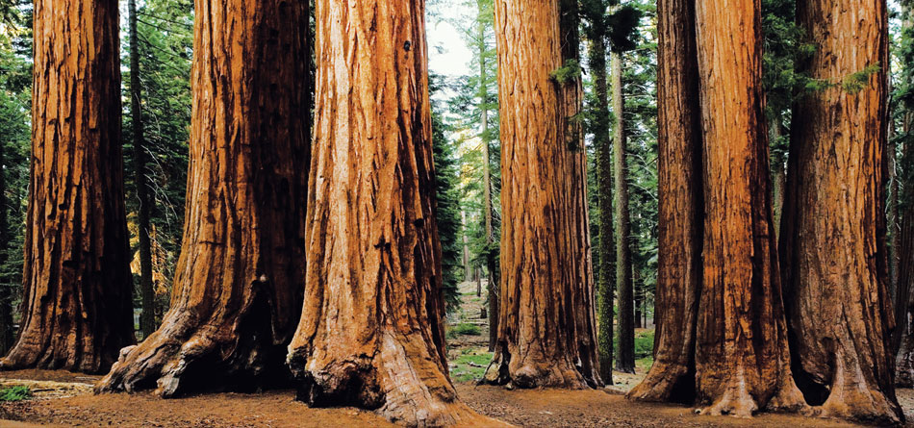
/ NORTH COAST
• 100 wineries
• First vines planted in the 1850s
• 16,700 acres (6,800 hectares) of winegrapes
MENDOCINO COUNTY– 60% of the county is covered in redwood forest, while vintners make good use of the rest
DiscoverCaliforniaWines.com
Notes:
Home to the world’s tallest living tree (370 feet or 113 meters), 60% of Mendocino County is covered in redwood forests which thrive in the same climate as winegrapes.
• 100 wineries
• First vines planted in the 1850s
• 16,700 acres (6,800 hectares) of winegrapes

Slide 35
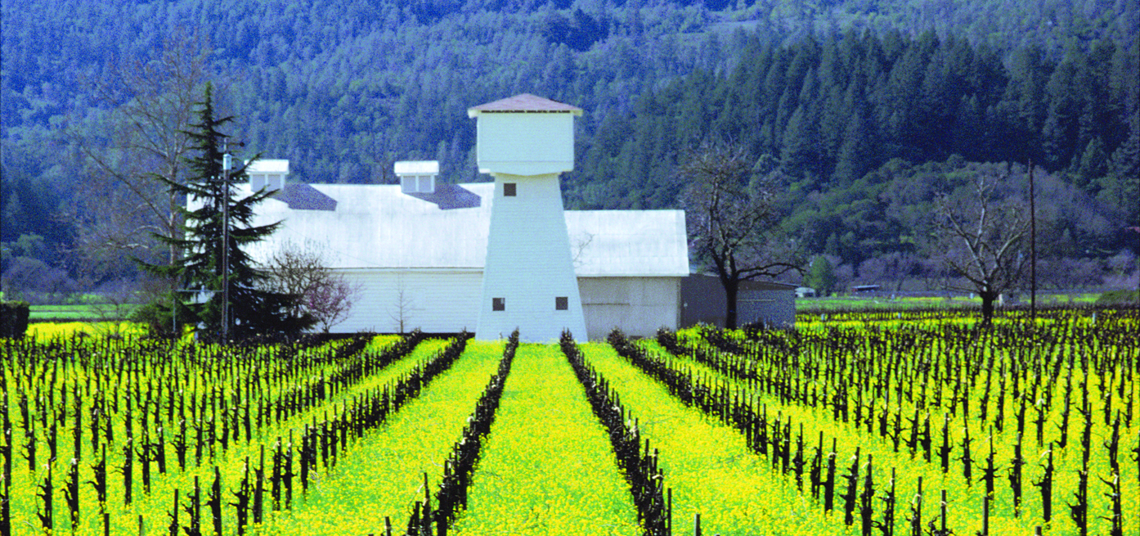
/ NORTH COAST
• Known worldwide, yet produces just 4% of all California wine
• Home to 600 wineries across 18 AVAs
• 45,000 acres (18,000 hectares) of winegrapes
NAPA VALLEY – Napa Valley’s world-renowned wines have found an equal match in the region’s cuisine
DiscoverCaliforniaWines.com
Notes:
The first region to be designated AVA status in 1981, Napa Valley produces just 4% of all California wine.
Napa Valley’s world-renowned wines have found an equal match in the region’s cuisine
Napa Valley is home to 600 wineries and 18 AVAs
Known worldwide, yet produces just 4% of all California wine
• 45,000 acres (18,000 hectares) of winegrapes

Slide 36
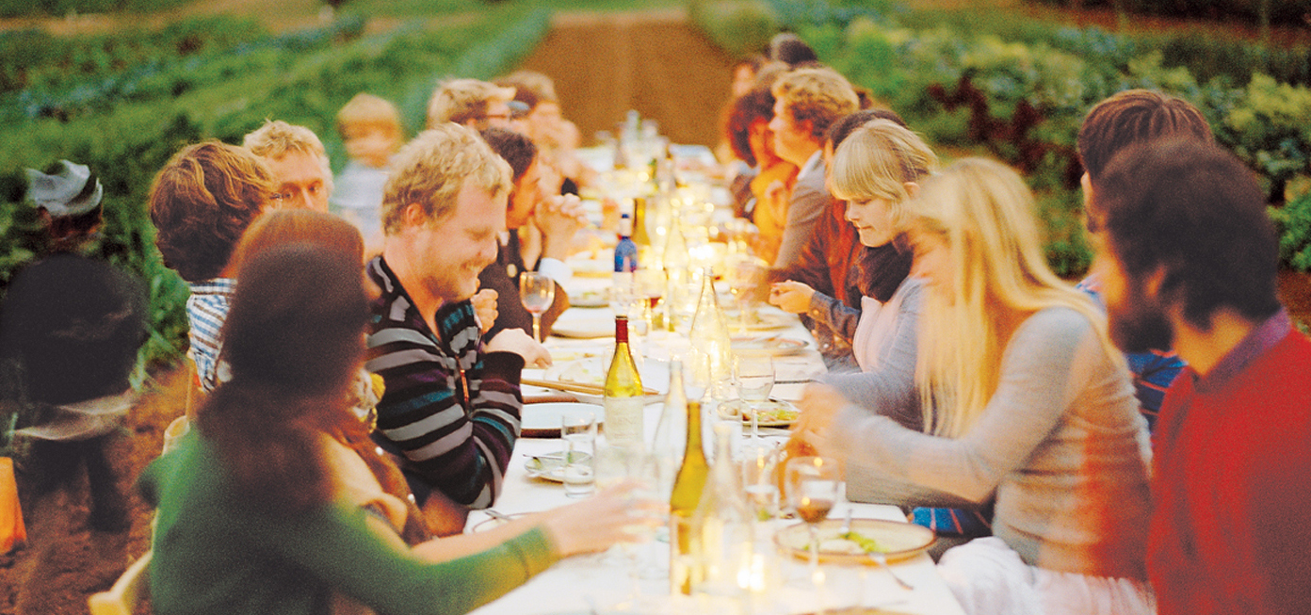
/ NORTH COAST
• 18 AVAs
• 500 wineries and counting
• 60,000 acres (24,000 hectares)
of winegrapes
SONOMA COUNTY – A nature lover’s paradise, Sonoma County grows more Pinot Noir than any county in the state
DiscoverCaliforniaWines.com
Notes:
Sonoma has been growing winegrapes since 1812.
Sonoma grows more Pinot Noir than any county in the state. Cabernet Sauvignon and Chardonnay are still the most widely planted grapes in the region.
Sonoma, a nature lover’s paradise, has 18 AVAs and more than 500 wineries.
• 60,000 acres (24,000 hectares) of winegrapes

Slide 37
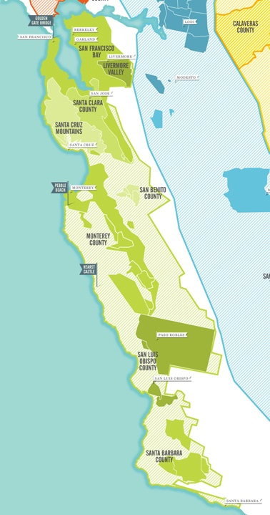
/ CENTRAL COAST
Central Coast (43 AVAs) and
Santa Cruz Mountains AVA
Weather transitions from cool coastal to warmer inland areas
One of the fastest growing wine regions in the state
Grapes have been cultivated here since the 1700s
DiscoverCaliforniaWines.com
Notes:
Some of the Central Coast’s best known regions include: Livermore Valley, Monterey County, Paso Robles, San Benito County, San Francisco Bay, San Luis Obispo County, Santa Barbara County, Santa Clara County and Santa Cruz Mountains, which is technically not part of the Central Coast AVA.
California’s Central Coast has 43 AVAs and also surrounds the Santa Cruz Mountains AVA
It is one of the fastest growing wine regions in the state, with nearly 350 wineries in San Luis Obispo/Paso Robles alone.
Grapes have been cultivated here since the 1700s.
This region is gaining more recognition as more wineries are established here.

Slide 38
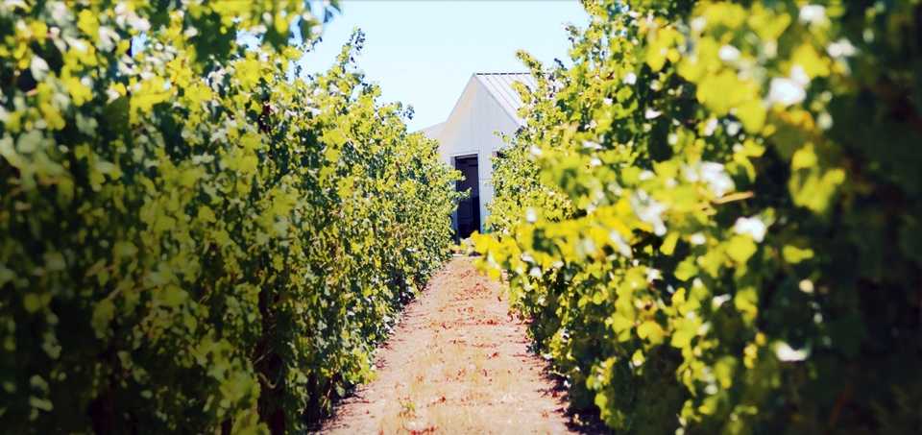
/ CENTRAL COAST
• 80% of California Chardonnay can be genetically traced to Livermore Valley
• 5,ooo acres (2,000 hectares) of winegrapes
• First in California to label Chardonnay, Petite Sirah and Sauvignon Blanc as varietals
LIVERMORE VALLEY– Pioneer Livermore winemakers C.H. Wente and James Concannon planted their vineyards in the early 1880s, having recognized the area’s winegrowing potential. Their descendants have maintained that tradition: both wineries continue to thrive.
DiscoverCaliforniaWines.com
Notes:
This region east of San Francisco was a pioneer in winegrowing and introduced the grape clone for Chardonnay that is the parent for 80% of California chardonnay grown today.
Livermore was the first region in California to label Chardonnay, Petite Sirah and Sauvignon Blanc as varietals
Pioneer Livermore winemakers C.H. Wente and James Concannon planted their vineyards in the early 1880s, having recognized the area’s winegrowing potential. Their descendants have maintained that tradition: both wineries continue to thrive.
5,000 acres (2,000 hectares) of winegrapes

Slide 39
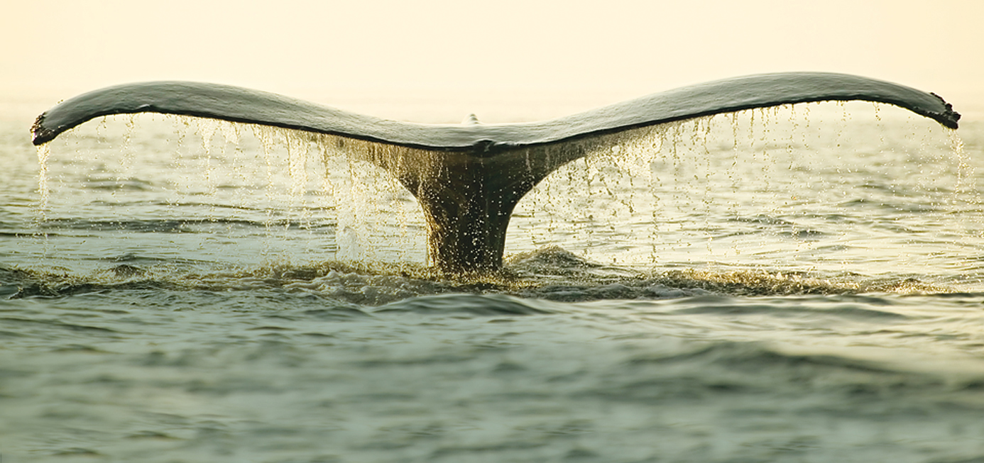
/ CENTRAL COAST
• 10 AVA’s
• 40,ooo acres (16,000 hectares) of winegrapes
• Home of the Lone Cypress, Monterey’s iconic 250 year old tree
MONTEREY COUNTY– A popular destination for wine and touring, the Monterey peninsula is also on the whale migration path, and home to Pebble Beach Golf Links
DiscoverCaliforniaWines.com
Notes:
Monterey is home to the “Blue Grand Canyon”, one of the world’s deepest marine canyons that contributes to the cool coastal weather.
A popular destination for wine and touring, the Monterey peninsula is also on the whale migration path, and home to Pebble Beach Golf Links
• 10 AVA’s
• 40,000 acres (16,000 hectares) of winegrapes
• Home of the Lone Cypress, Monterey’s iconic 250 year old tree

Slide 40
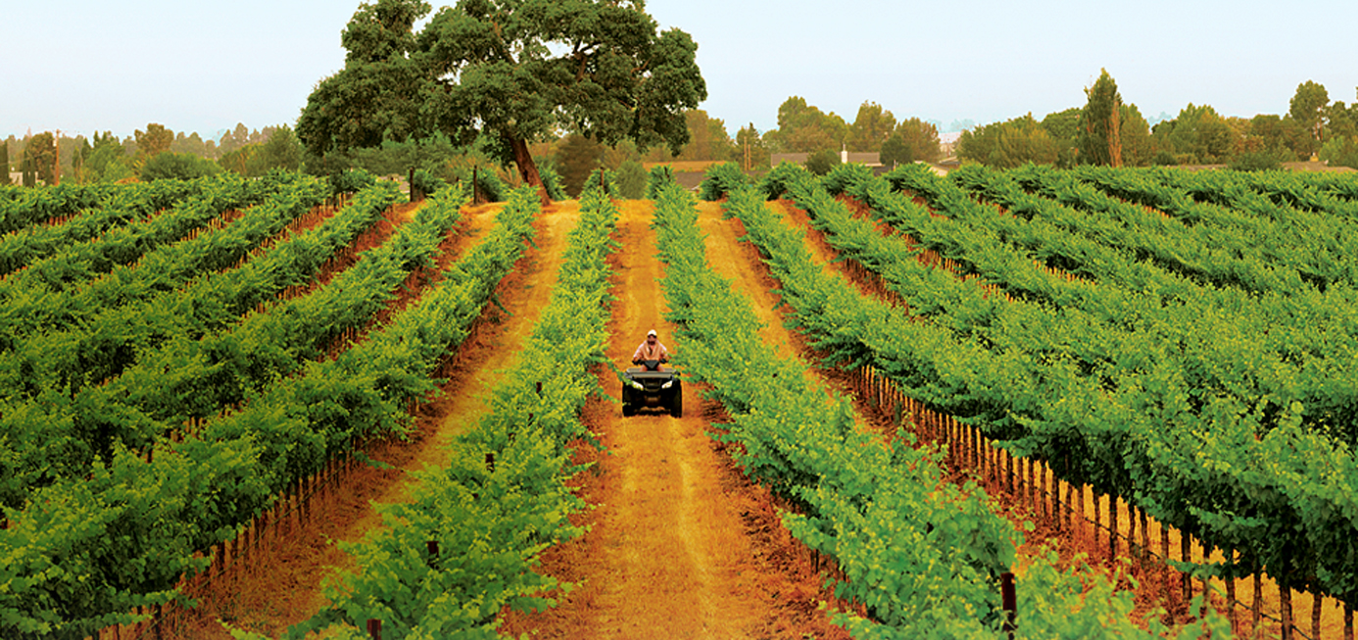
/ CENTRAL COAST
California’s fastest growing wine region
180 wineries
26,000 vineyard acres
(10,500 hectares)
• California’s fastest growing wine region
• > 200 wineries
• 40,000 vineyard acres (16,200 hectares)
PASO ROBLES – Located halfway between San Francisco and Los Angeles, Paso Robles is a hot spot for Rhône varietals and blends
DiscoverCaliforniaWines.com
Notes:
Located in San Luis Obispo country, the first vines in Paso Robles were planted in the 1790s, and today it is one of California’s fastest growing wine regions, with 200 wineries and growing.
Located halfway between San Francisco and Los Angeles, Paso Robles is a hot spot for Rhône varietals and blends
40,000 vineyard acres (16,200 hectares)

Slide 41
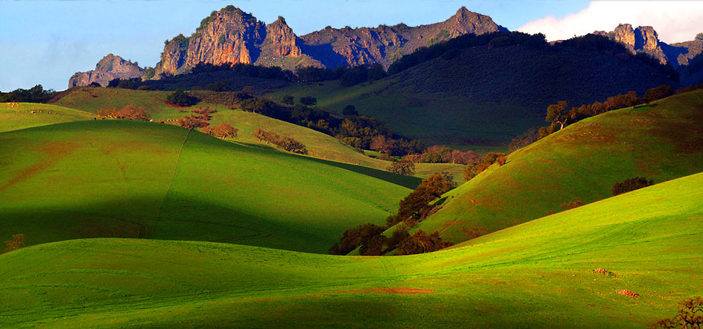
/ CENTRAL COAST
Unparalleled scenic beauty
SAN BENITO COUNTY – French and German immigrants planted the first grapes here in the mid-1800s near what is now known as Pinnacles National Monument
DiscoverCaliforniaWines.com
Notes:
Located along El Camino Real (The King’s Highway), rugged San Benito County is located north of Monterey County on California’s beautiful Central Coast.
French & German immigrants established its wine culture, planting the first grapes there in 1854.

Slide 42
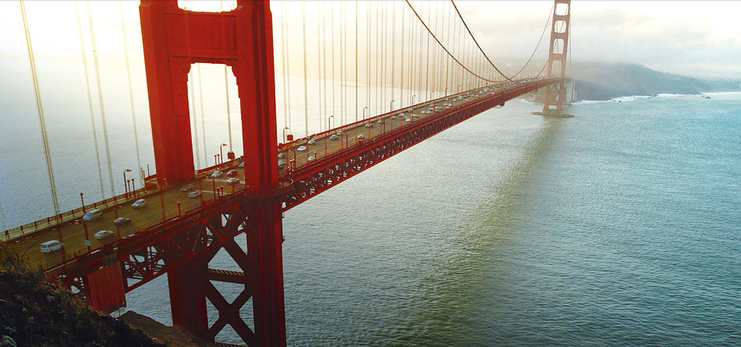
/ CENTRAL COAST
SAN FRANCISCO BAY – Surrounded by mountains, valleys and fertile farmland, San Francisco is a cornucopia of food, wine, ethnic diversity and natural beauty
DiscoverCaliforniaWines.com
Notes:
Cooled by the famous fog of San Francisco Bay, San Francisco is the jewel of the West Coast with its world-renowned bridges, steep hills, and regal Victorian architecture.
San Francisco boasts more restaurants per capita than any city in the U.S. and is an epicenter for wine and food trends.
Wineries located in San Francisco, Oakland, Berkeley and elsewhere are part of a statewide urban wine movement

Slide 43
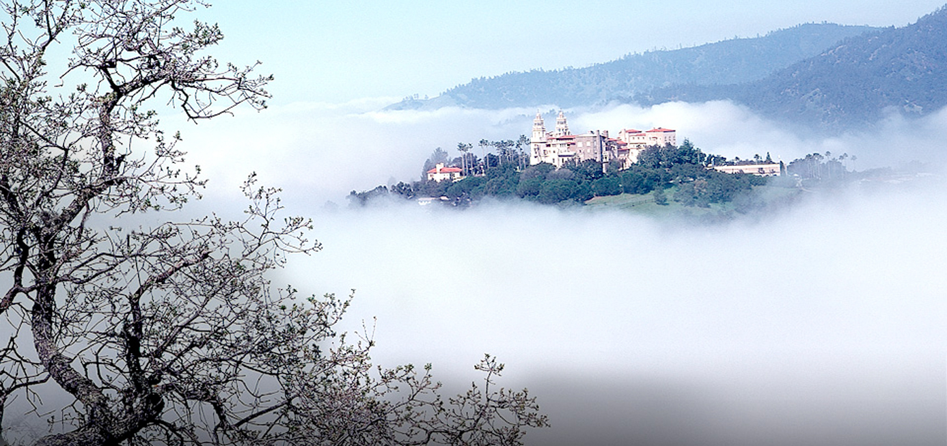
/ CENTRAL COAST
SAN LUIS OBISPO COUNTY – A scenic wine region known for its Rhône blends, heritage Zinfandels, Pinot Noirs and Chardonnays
DiscoverCaliforniaWines.com
Notes:
The crown of San Luis Obispo is Hearst Castle, the grand 65-room estate built by newspaper mogul William Randolph Hearst in 1919.
With more than 350 wineries, this scenic winegrowing region of coastal valleys and inland hills is tempered by maritime breezes and is know for its Rhone blends, heritage Zinfandels, Pinot Noirs and Chardonnays.

Slide 44
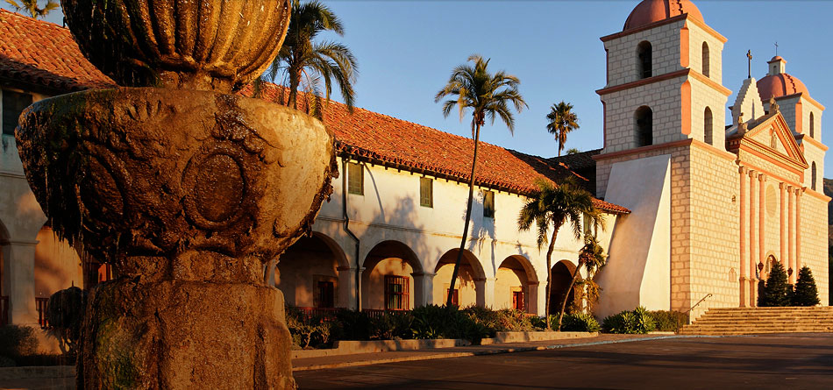
/ CENTRAL COAST
Unparalleled scenic beauty
• 7 AVA’s
• 20,000 acres (8,000 hectares) of winegrapes
• 200 bonded wineries
SANTA BARBARA COUNTY – Long a favorite hideaway for movie stars, it’s also a famous wine destination, featuring the area’s signature Pinot Noir
DiscoverCaliforniaWines.com
Notes:
160 kilometers (100 miles) north of Los Angeles, the Santa Barbara region has been growing grapes since 1782.
25% of the grapes grown in the county are Pinot Noir.
Made famous by the 2004 film Sideways which won an Oscar for best screenplay.
Long a favorite hideaway for movie stars, it’s also a famous wine destination, featuring the area’s signature Pinot Noir
• 7 AVA’s
• 20,000 acres (8,000 hectares) of winegrapes
• 200 bonded wineries

Slide 45
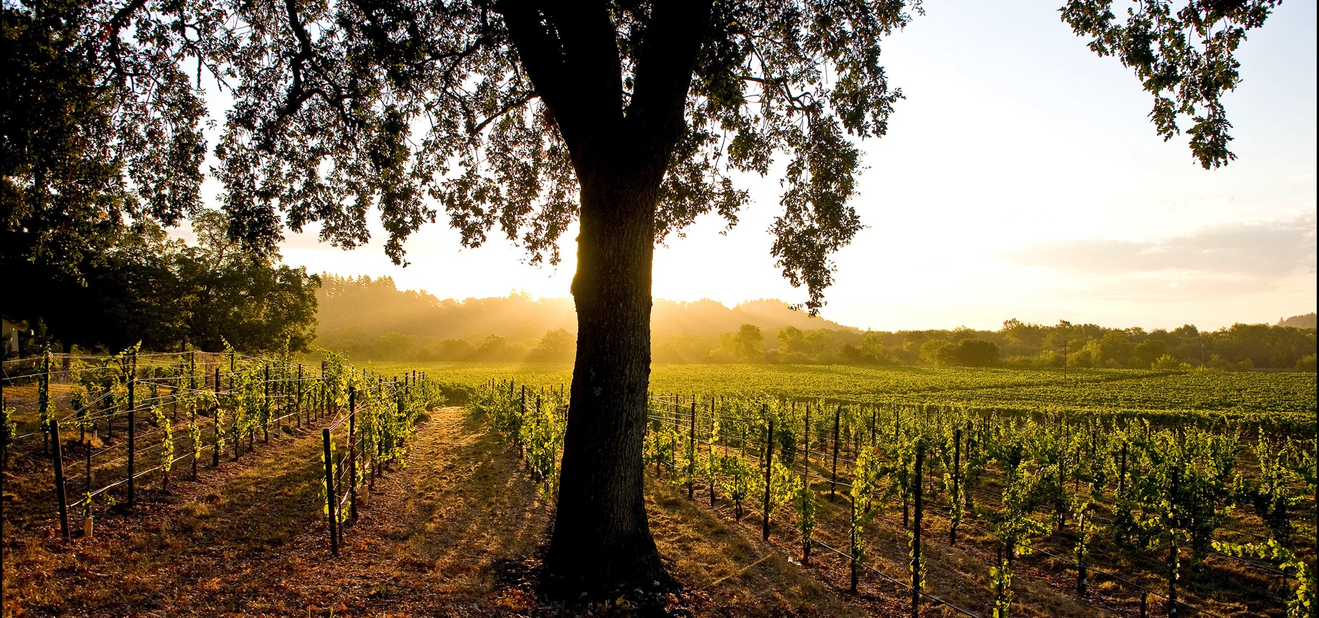
/ CENTRAL COAST
Unparalleled scenic beauty
SANTA CLARA COUNTY – An area with rich soils and Mediterranean climate, Native Americans named it the “Valley of the Heart’s Delight”
DiscoverCaliforniaWines.com
Notes:
Also know as Silicon Valley, Santa Clara is a hotbed for the world’s leading technology companies, including Google, Facebook and Apple
An area with rich soils and Mediterranean climate, Native Americans named it the “Valley of the Heart’s Delight”

Slide 46
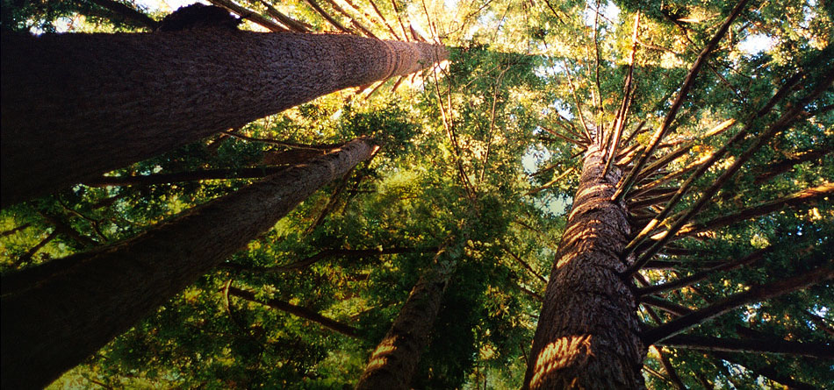
/ CENTRAL COAST VICINITY
SANTA CRUZ MOUNTAINS – Rich with wooded peaks and small vineyards tucked into quiet hillsides
DiscoverCaliforniaWines.com
Notes:
Santa Cruz Mountains is surrounded by the Central Coast AVA although it is technically not a part of that macro region
One of California’s first AVAs, established in 1981, the Santa Cruz Mountains region is known for Pinot Noir, Chardonnay and Cabernet Sauvignon.
This high-elevation, cool climate winegrowing region has over 600 hectares (1,500 acres) of vineyards.
Rich with wooded peaks and small vineyards tucked into quiet hillsides

Slide 47
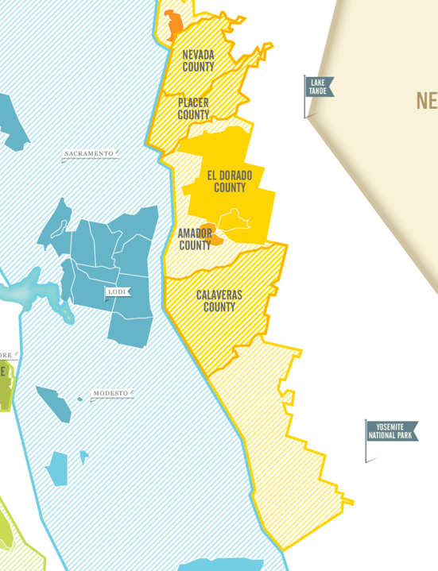
/ SIERRA FOOTHILLS
Sierra Foothills (6 AVAs)
The epicenter of the California Gold Rush, immigrants who sought fortune in the mines here left their vines in the soil
Now, a vibrant region for winegrapes and touring
DiscoverCaliforniaWines.com
Notes:
Some of the Sierra Foothills’ best known regions include: Amador County, El Dorado County, Nevada County and Placer County
California’s Sierra Foothills region has 6 AVAs.
This area became the epicenter of the California Gold Rush.
Gold was first discovered near Sacramento in 1848. The Gold Rush of 1849 caused California’s population to soar by a half a million, from an estimated 14,000 (exclusive of Native Americans), making it one of the largest migrations of people in history. For many, “gold fever” became “vine fever” as news of winegrower profits spread and vineyard trials showed that California’s sunshine allowed grapes to ripen fully nearly everywhere in the state.
Known for Zinfandels, the area is now a vibrant region for winegrapes and touring. The area is home to Yosemite National Park and Lake Tahoe.

Slide 48
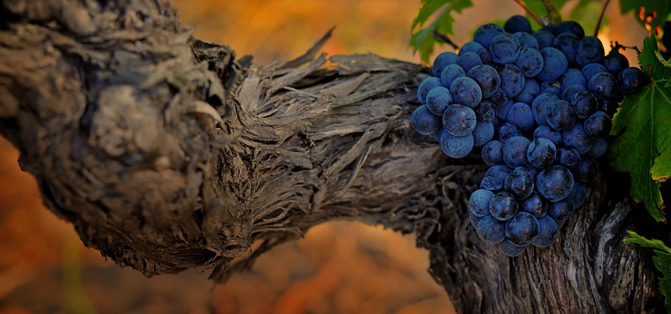
/ SIERRA FOOTHILLS
Unparalleled scenic beauty
AMADOR COUNTY – Nestled in the heart of Gold Country, this region is known for its rich history and rich red wines
DiscoverCaliforniaWines.com
Notes:
Amador is old vine country: nearly 600 acres (243 hectares) of the county’s vines are at least 60 years old, while several vineyards date to the 19th century
The area is known for old vine Zinfandel, Barbera, Sangiovese, Syrah and Viognier

Slide 49
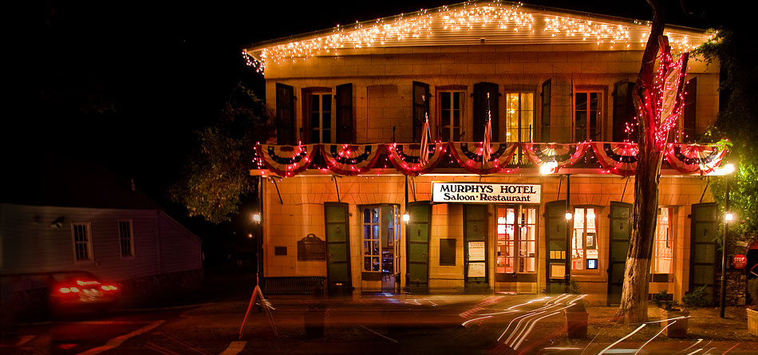
/ SIERRA FOOTHILLS
Unparalleled scenic beauty
CALAVERAS COUNTY – Known for Syrah, Merlot and Cabernet Sauvignon, Calaveras County maintains its 19th-century Gold Rush-era charm
DiscoverCaliforniaWines.com
Notes:
Mark Twain gave Calaveras County its claim to fame with his best selling story, “The Jumping Frog of Calaveras County”.
Calaveras County boasts a natural wonder, the Calaveras Big Trees, a grove of giant sequoias.
Known for Syrah, Merlot and Cabernet Sauvignon, Calaveras County maintains its 19th-century Gold Rush-era charm

Slide 50
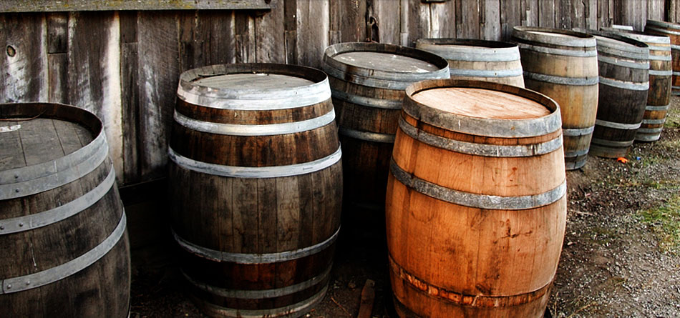
/ SIERRA FOOTHILLS
Unparalleled scenic beauty
EL DORADO COUNTY – Sitting at the north end of California’s famed Mother Lode, El Dorado County is known for its old vine Zinfandel
DiscoverCaliforniaWines.com
Notes:
El Dorado is Spanish for “the gilded one”, a reference to its location at the north end of the Mother Lode, the 120 mile (193 kilometers) gold vein discovered in the late 1840s, which became the site of the gold rush.
El Dorado produces more than 50 different winegrape varieties, dominated by Zinfandel.
The region has high elevation vineyards at 200 meters (600 feet)

Slide 51
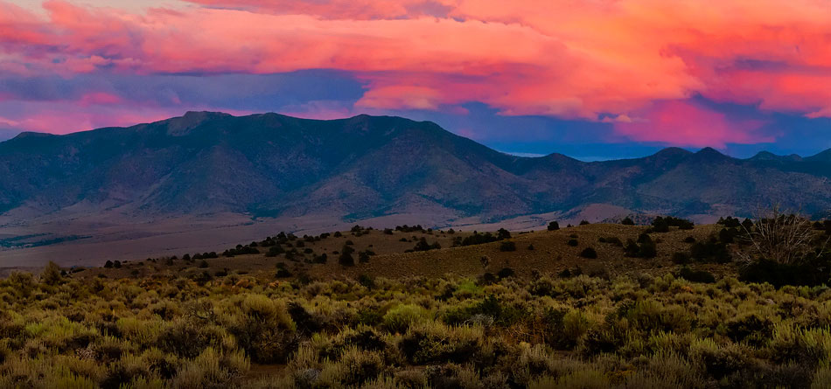
/ SIERRA FOOTHILLS
Unparalleled scenic beauty
NEVADA COUNTY – Enjoy the quaint, historic towns of Nevada City and Grass Valley, fresh snow at Sugar Bowl Resort, and the region’s reemerging wine culture
DiscoverCaliforniaWines.com
Notes:
Named a decade before the state of Nevada which sits directly to its east, Nevada County is part of California’s historic gold country.
Visitors today can relive another era on the historic Nevada County Railroad, experience fresh snow at Sugar Bowl Ski Resort, or discover the region’s reemerging wine culture.
Home to the quaint, historic towns of Nevada City and Grass Valley.

Slide 52
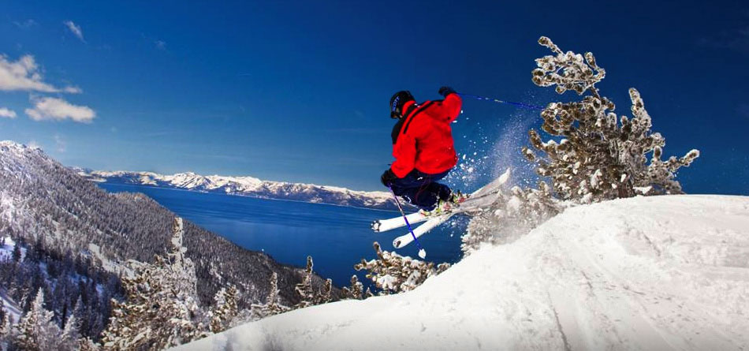
/ SIERRA FOOTHILLS
Unparalleled scenic beauty
PLACER COUNTY – The county is the gateway to Lake Tahoe and ski resorts. Many Gold Rush miners became vintners as the region slowly transformed from Gold Country to farmland in the late 19th century
DiscoverCaliforniaWines.com
Notes:
Placer County is home to Lake Tahoe, the largest alpine lake in North America and a world class skiing destination.
The mighty American River runs through this region which boasts 16 wineries.

Slide 53
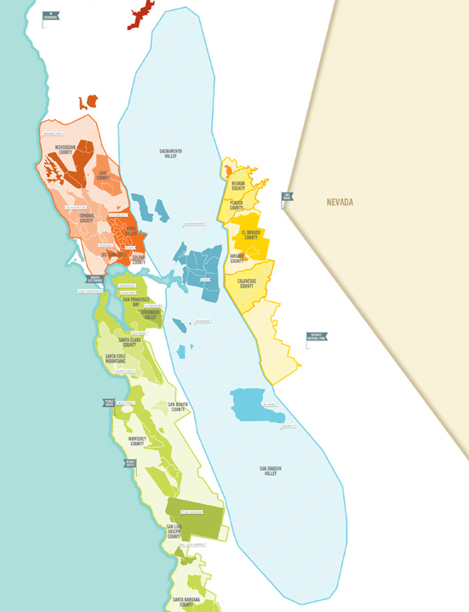
/ INLAND VALLEYS
Inland Valleys (18 AVAs)
One of the most fertile farmlands in the world, California’s sunny inland valleys are great for grapes and hundreds of other agricultural crops
DiscoverCaliforniaWines.com
Notes:
Some of the Inland Valleys’ best know regions include: Lodi & the Delta, Madera County, Sacramento Valley and San Joaquin Valley
California’s Inland Valleys have 18 AVAs. It comprises two valleys--San Joaquin Valley and Sacramento Valley. This vast region stretches from Redding in the north to Bakersfield in the south.
One of the most fertile farmlands in the world, California’s sunny inland valleys are great for grapes and 400 agricultural crops. This area grows 40% of America’s fruits, vegetables and other crops.
This area is home to prominent academic institutions with world class programs for viticulture and enology – the University of California at Davis and Fresno State University.

Slide 54
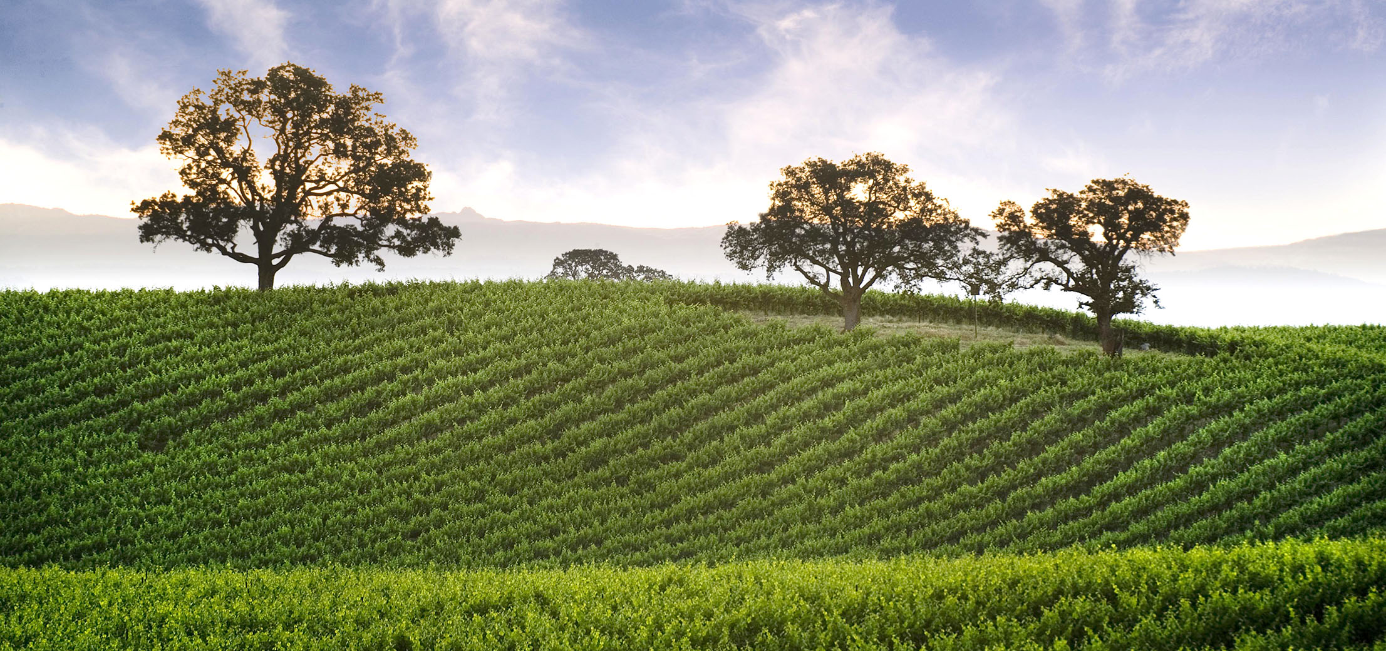
/ INLAND VALLEYS
Where the Sacramento and San Joaquin Valleys meet
100,000 vineyard acres (40,500 hectares)
• Where the Sacramento and San Joaquin Valleys meet
• 100,000 vineyard acres (40,500 hectares)
LODI AND THE DELTA – Planted during the Gold Rush, Lodi’s vineyards are home to some of the country’s finest Zinfandel
DiscoverCaliforniaWines.com
Notes:
Nestled between the San Francisco Bay and the Sierra Nevada Mountains and located between the Sacramento and San Joaquin Valleys, Lodi Wine Country is a fast growing wine region.
Many of Lodi’s winegrowing families have been growing grapes for more than 100 years, and over the last decade have transitioned to winemaking as well.
Planted during the Gold Rush, Lodi’s vineyards are home to some of the country’s finest Zinfandel.
The region also produces a range of wines from traditional grapes such as Cabernet Sauvignon and Chardonnay to up and coming varieties like Pinot Gris, Verdelho, and Tempranillo

Slide 55
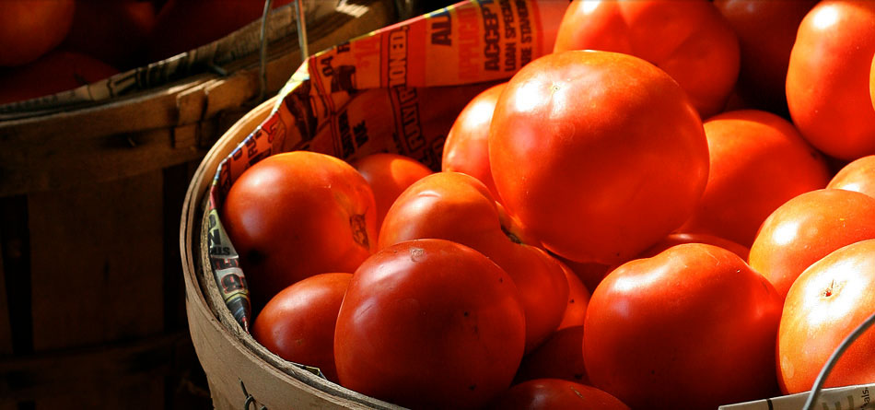
/ INLAND VALLEYS
Unparalleled scenic beauty
MADERA COUNTY – The county’s fertile farmlands are its most precious resource, producing almonds, figs, cotton, and tomatoes. There are 38,000 acres (15,000 hectares) dedicated to winegrapes.
DiscoverCaliforniaWines.com
Notes:
Centrally located in the San Joaquin Valley, Madera is known for its dessert and port-style wines, among others, and has been growing grapes since the late 1800s.
A dozen wineries sit along the popular Madera Wine Trail.
Today the county’s fertile farmlands are its most precious resource, producing almonds, figs, cotton and tomatoes.

Slide 56

/ INLAND VALLEYS
Unparalleled scenic beauty
SACRAMENTO VALLEY – Home to the state capital, few regions have produced more history – and wine has played an important part
DiscoverCaliforniaWines.com
Notes:
Nestled between the Sierra Nevada and Coastal Range mountains, Sacramento Valley was discovered by Spanish explorers in the 1500s.
The area has 3,200 vineyard hectares (8,000 acres) of winegrapes and is a thriving agriculture center.
Home to the state capital in Sacramento County, few regions have produced more history – and wine has played an important part.

Slide 57

/ INLAND VALLEYS
Unparalleled scenic beauty
SAN JOAQUIN VALLEY– The state’s largest winegrowing area has also been called “the food basket of the world”
DiscoverCaliforniaWines.com
Notes:
The largest valley in the state, the San Joaquin Valley is called the “food basket of the world”.
Specialty crops grown here include almonds, asparagus, pistachios, oranges, peaches, garlic, tangerines, tomatoes, kiwis, hay, alfalfa, raisins and winegrapes.
San Joaquin Valley covers 7 counties and 9 AVAs.

Slide 58

/ INLAND VALLEYS
Unparalleled scenic beauty
YOLO COUNTY – This emerging wine region with four AVAs –Capay Valley, Clarksburg, Merritt Island and Dunnigan Hills – has grown winegrapes since the 1860s
DiscoverCaliforniaWines.com
Notes:
Known for its rich soil, warm days and mild delta breezes, this emerging wine region sits east of Napa, on the other side of the Vaca Mountains in the Sacramento Valley
Yolo County has three AVAs – Capay Valley, Clarksburg, Merritt Island and Dunnigan Hills – and has grown winegrapes since the 1860s

Slide 59

/ SOUTHERN CALIFORNIA
Southern California (11 AVAs)
Southern California celebrities share the blue skies, sunshine and famous beaches with quiet vineyards tucked into rolling valleys and foothills
DiscoverCaliforniaWines.com
Notes:
Some of Southern California’s best known regions include: Cucamonga Valley, Los Angeles Area, San Diego County and Temecula Valley
Southern California has 11 AVAs, including the new Malibu Coast AVA.
Here celebrities share the blue skies, sunshine and famous beaches with quiet vineyards tucked into rolling valleys and foothills.
Temecula Valley wineries, located south of the country’s largest wine market—Los Angeles—have become a destination for wine lovers. Many wineries offer not only tasting, but restaurants, live music and accommodations. Other wine areas in Southern California include Ventura, Malibu, Cucamonga Valley and San Diego.

Slide 60

/ SOUTHERN CALIFORNIA
Unparalleled scenic beauty
CUCAMONGA VALLEY – A rich wine culture continues today based on Cucamonga’s winegrowing dominance of the early 1900s
DiscoverCaliforniaWines.com
Notes:
Due east of Los Angeles, overlapping San Bernardino and Riverside counties, Cucamonga Valley was a dominant winegrowing region of California in the early 1900s.
The wine culture continues today with founding families farming some of their original acreage and welcoming visitors to sample diverse wines and special history.

Slide 61

/ SOUTHERN CALIFORNIA
Unparalleled scenic beauty
LOS ANGELES AREA – The entertainment capital for movies, music and television, LA’s coastal areas are home to countless movie stars, legendary surf shops, fabulous restaurants and high-elevation wineries
DiscoverCaliforniaWines.com
Notes:
The entertainment capital for movies, music and television, Los Angeles’ coastal areas are home to countless movie stars, legendary surf shops, fabulous restaurants and high-elevation wineries.
The Los Angeles area has almost 20 wineries located near the Pacific Coast Highway in Ventura County and Malibu.

Slide 62

/ SOUTHERN CALIFORNIA
Unparalleled scenic beauty
SAN DIEGO COUNTY – Established in the 1700s, this region has been growing winegrapes longer than nearly any other county in the state
DiscoverCaliforniaWines.com
Notes:
San Diego has been growing winegrapes longer than nearly any other county in the state, and is home to the state’s oldest winegrowing mission, Mission San Diego de Alcala, established in 1769.
Today this southernmost winegrowing region in California has 50 wineries and counting.
With its long beaches and temperate climate, San Diego is one of the state’s most popular tourist destinations

Slide 63

/ SOUTHERN CALIFORNIA
Unparalleled scenic beauty
TEMECULA VALLEY – Tempered by coastal fog, this region is best known for its Italian and Rhône varietals – and its annual Balloon and Wine Festival
DiscoverCaliforniaWines.com
Notes:
Temecula Valley has been growing winegrapes since the late 1700s and gained AVA status in 1984.
Tempered by coastal fog, this region is best known for its Italian and Rhone varietals, and its annual Balloon and Wine Festival.
The region is home to nearly 40 wineries and has 525 vineyard hectares (1,300 acres) under vine.

Slide 64

Far North California (5 AVAs)
This northernmost region is home to
the “Lost Coast”
Humboldt, Siskiyou, Trinity, Shasta and Tehama counties offer diverse winegrowing areas and landscapes from redwood forest canyons to the Pacific Ocean
DiscoverCaliforniaWines.com
Notes:
This is the northernmost of California’s winegrowing regions, and is home to the “Lost Coast,” a remote and beautiful area of California’s coast, and the new Manton Valley AVA east of Redding.
Humboldt, Siskiyou, Trinity, Shasta and Tehama counties offer diverse winegrowing areas and landscapes from redwood forest canyons to the Pacific Ocean.

Slide 65
138 AVAs (designated winegrape-growing areas) recognized by the
U.S. government
DiscoverCaliforniaWines.com
Notes:
138 AVAs (designated winegrape-growing areas) recognized by the U.S. government

Slide 66
What’s an AVA?
American Viticultural Area – U.S. government designated winegrowing region
DiscoverCaliforniaWines.com
Notes:
What’s an AVA? American Viticultural Area – U.S. government designated winegrowing region

Slide 67
California on the label means 100% of the grapes
are from California
DiscoverCaliforniaWines.com
Notes:
California on the label means 100% of the grapes are from California

Slide 68

Unparalleled scenic beauty
A dazzling variety of reds, whites, rosés and sparkling wines
DiscoverCaliforniaWines.com
Notes:
California’s wines offer great diversity, quality and value at all price points.

Slide 69

/ CALIFORNIA RED WINES
Barbera
Cabernet Franc
Cabernet Sauvignon
Grenache
Malbec
Merlot
Mourvédre
Petite Sirah
Pinot Noir
Red Blends
Sangiovese
Syrah
Tempranillo
Zinfandel
DiscoverCaliforniaWines.com
Notes:
Here is a list of the top red wine varietals grown in California – (this is alphabetical order and not based on acreage or wine production)
Cabernet Sauvignon is the top-selling red wine, followed by Merlot and Pinot Noir.
California’s signature varietal is Zinfandel because of its unique history here.

Slide 70

/ CALIFORNIA WHITE WINES
Chardonnay
Chenin Blanc
Gewurztraminer
Grenache Blanc
Marsanne
Moscato/Muscat
Pinot Blanc
Pinot Grigio
Riesling
Rousanne
Sauvignon Blanc
Semillon
Viognier
White Blends
DiscoverCaliforniaWines.com
Notes:
Here is a list of the main white wine varietals grown in California – (this is alphabetical order and not based on acreage or wine production)
Chardonnay is the top selling white wine, followed by Pinot Grigio and Sauvignon Blanc. Moscato and Riesling show strong growth in acreage.

Slide 71

/ ROSÉ, SPARKLING AND DESSERT WINES
California Rosé Wines
The subtle berry flavors of rosé are especially refreshing on cool autumn evenings and hot summer days
California Sparkling Wines
The crisp acidity of California sparkling wine pairs well with a wide range of foods and occasions
California Dessert Wines
Also called late harvest wines, these deep elixirs provide a sweet end to any meal
DiscoverCaliforniaWines.com
Notes:
California Rosé Wines: The subtle berry flavors of rosé are especially refreshing on cool autumn evenings and hot summer days
California Sparkling Wines: The crisp acidity of California sparkling wine pairs well with a wide range of foods and occasions
California Dessert Wines: Also called late harvest wines, these deep elixirs provide a sweet end to any meal
These wines range from very dry to sweet and pair well with a variety of food

Slide 72
HOW TO READ A WINE LABEL
01 – Winery Name
02 – Varietal or blend
03 – Place of Origin
04 – Vineyard
05 – Vintage Year
DiscoverCaliforniaWines.com

Slide 73
“Wine had such ill effects on Noah’s health it was all he could do to live 950 years.”
Will Rogers
DiscoverCaliforniaWines.com
Notes:
“Wine had such ill effects on Noah’s health it was all he could do to live 950 years.” --Will Rogers

Slide 74

Sustainable Winegrowing:
Good for the environment
and community –
great for the wine
DiscoverCaliforniaWines.com
Notes:
Now we would like to talk to you about Sustainable winegrowing, which is a major focus of the California wine industry
In California we define sustainability as practices that are good for the environment, both vineyards & wineries; good for communities – neighbors & employees; and good for the long term economic viability of the state’s vineyards and wineries

Slide 75

California has some of the strongest environmental and labor laws and regulations in the world
California vintners and growers have long been environmental stewards and active members of their communities
California wineries and vineyards are primarily family owned with a commitment to preserving the health and beauty of the land for future generations
DiscoverCaliforniaWines.com
Notes:
California is the most populous state in the U.S. and is growing every year. As a result, there is competition for land, water, energy and other limited natural resources.
The California wine community established the Code of Sustainable Winegrowing program to use resources wisely, and to pass healthy, sustainable businesses to family and the next generation.
Some background about California and its wine industry includes:
California has some of the strongest environmental and labor laws and regulations in the world
California vintners and growers have long been environmental stewards and active members of their communities
California wineries and vineyards are primarily family owned with a commitment to preserving the health and beauty of the land for future generations

Slide 76


/ CALIFORNIA SUSTAINABLE WINEGROWING ALLIANCE
California Sustainable Winegrowing Alliance
Provides tools to help wineries and vineyards continuously improve in adopting and implementing practices that benefit the environment, employees, communities, and high quality wine
DiscoverCaliforniaWines.com
Notes:
In California we define sustainability as practices that are good for the environment, both vineyards & wineries; communities – neighbors & employees; and the long term economic viability of the winery or vineyard business itself

Slide 77


/ CALIFORNIA CODE OF SUSTAINABLE WINEGROWING
A Code to Live By
Wine Institute and the California Association of Winegrape Growers introduced the Code of Sustainable Winegrowing in 2002
Covers more than 200 best sustainable practices
2,100 wineries and vineyards representing 75% of vineyard acres and 80% of winery case production are participating in the California Sustainable Winegrowing Program, which is based on the Code.
DiscoverCaliforniaWines.com
Notes:
The program is over a decade old and is one of the most widely adopted sustainable winegrowing programs in the world.
The program includes 200 sustainable practices from grape to glass.
2,100 wineries and vineyards representing 75% of vineyard acres and 80% of winery case production are participating in the California Sustainable Winegrowing Program, which is based on the Code.

Slide 78

/ THREE E’s
California winegrape growing and winemaking is guided by the Three E’s of sustainability:
Environmentally sound
Economically feasible
Socially Equitable practices
DiscoverCaliforniaWines.com
Notes:
California winegrape growing and winemaking is guided by the Three E’s of sustainability:
Environmentally sound
Economically feasible
Socially Equitable practices

Slide 79


/ PRACTICES IN VINEYARDS & WINERIES
Managing vineyards for sustainability and quality fruit
Conserving water and energy
Protecting air and water quality
Maintaining healthy soil
Reducing pesticide use
Preserving local ecosystems and wildlife habitats
Recycling natural resources
Practicing environmentally preferred purchasing
Enhancing relations with employees and communities
DiscoverCaliforniaWines.com
Notes:
There are over 200 practices in the Code of Sustainable Winegrowing that encompass activities in vineyards & wineries, employees, community relations, and here are some examples:
Managing vineyards for sustainability and quality fruit
Conserving water and energy
Protecting air and water quality
Maintaining healthy soil
Reducing pesticide use
Preserving local ecosystems and wildlife habitats
Recycling natural resources
Practicing environmentally preferred purchasing
Enhancing relations with employees and communities

Slide 80








/ CERTIFIED CALIFORNIA SUSTAINABLE WINEGROWING
Certified California Sustainable Winegrowing (CCSW)
Based on the California Code of Sustainable Winegrowing, CCSW provides third-party verification of the adoption of practices and progress towards goals
California certification programs:
DiscoverCaliforniaWines.com
Notes:
Introduced in 2010, certification based on the California Code of Sustainable Winegrowing provides 3rd-party verification of the adoption of practices by a vineyard or winery and their progress in continuous improvement.
In addition to an annual assessment, certification requires meeting 50 vineyard and 32 winery standards.
In addition to Certified California Sustainable Winegrowing (CCSW) there are a number of other programs active in the state that offer regional or statewide certification.
These include: Lodi Rules, SIP-Certified, Fish Friendly Farming, Napa Green Winery and Land certifications and the Bay Area Green Business Program.
All of these California programs play an important role in the ever-expanding tapestry of the California wine community’s efforts to produce high quality wine that is environmentally sound, economically feasible and socially equitable.

Slide 81

/ ORGANIC
Organic
Wines “made with organically grown grapes” come from vineyards that follow the guidelines set by the U.S. National Organic Program:
No synthetic pesticides or nonorganic chemicals
Natural alternatives to soil enrichment and managing pests, weeds and vine disease
In addition to being made with organically grown grapes, wines labeled “organic” cannot have added sulfites to prolong shelf life
DiscoverCaliforniaWines.com
Notes:
Organic is a very important part of California’s green trend.
Wines “made with organically grown grapes” come from vineyards that follow the guidelines set by the U.S. National Organic Program
As you can see, there are similarities to the goals and practices between organic and sustainability with regard to vineyard management practices.
Organic focuses on specific practices that are required or prohibited.
Sustainability also focuses on practices but provides more flexibility for regional differences which are an important factor in California, where the distance and growing conditions among our winegrowing regions are vastly different. Sustainability also covers winery and people practices.

Slide 82

/ BIODYNAMIC
Biodynamic
Biodynamic farming treats the vineyard as a closed system.
No synthetic pesticides or nonorganic chemicals
Compost teas and natural preparations to enrich soil and promote microorganisms
Insectaries to control pests
Planting and pruning determined by the phases of the moon
DiscoverCaliforniaWines.com
Notes:
Biodynamic has very dedicated practitioners in the California wine community.
Biodynamic farming treats the vineyard as a closed system.
There are wineries and vineyards in California that use one, two or all three of these programs for various reasons

Slide 83
“Good wine is a
necessity of life for me.”
Thomas Jefferson
DiscoverCaliforniaWines.com
Notes:
“Good wine is a necessity of life for me.” --Thomas Jefferson

Slide 84

Unparalleled scenic beauty
California cuisine is fusion at its finest and most flavorful
California wines pair extremely well with a vast array of food – from fresh California cuisine to the best local specialties from around the world
DiscoverCaliforniaWines.com
Notes:
There are many ethnic influences in California cuisine, from the Italians, Germans and Irish to Asians and Latinos of the present day. California wines pair well with a variety of foods, from fresh California cuisine to the best local specialties from around the world.
The diversity of winegrowing regions in California, with 135 AVAs, creates differences in wine styles even within the same varietal.
California grows more than 110 different winegrape varieties. Cabernet Sauvignon is the most popular red grape and Chardonnay is the most popular white grape. Zinfandel is California’s heritage grape. Blends are a growing trend among California wineries, as are aromatic whites like Moscato and Pinot Grigio.
The availability of more than 400 local farm crops and the diversity of ethnic cultures in California have inspired chefs to create a vast array of new and fresh dishes here, all paired with local California wines.
Visitors enjoy the more than 60,000 eating and drinking places in California.

Slide 85

/ PAIRING WITH CALIFORNIA RED WINES
Cabernet Sauvignon
Pair with grass-fed beef, whether grilled, roasted, braised or stir-fried
Petite Sirah
Pair with barbequed chicken, a cold roast beef sandwich with mustard, or mild blue cheeses
Merlot
Pair with sautéed duck breast or roasted pork tenderloin
DiscoverCaliforniaWines.com
Notes:
Here are some suggested red wine pairings with some of our popular varietals. But the rule in California is to drink what you enjoy and try your own combinations.
Cabernet Sauvignon - Pair with grass-fed beef, whether grilled, roasted, braised or stir-fried
Petite Sirah - Pair with barbequed chicken, a cold roast beef sandwich with mustard, or mild blue cheeses
Merlot - Pair with sautéed duck breast or roasted pork tenderloin

Slide 86

/ PAIRING WITH CALIFORNIA RED WINES
Try this:
Marinated Grilled Rib-eye Steak with Roasted Pepper Salsa and Fresh Corn Fritters
This tender grilled steak with smoky, spiced salsa is served alongside crunchy fresh-corn fritters.
Enjoy with California Cabernet Sauvignon or Cabernet Franc.
DiscoverCaliforniaWines.com
Notes:
Our temperate climate allows for cooking outdoors year round. And grilled and barbecued dishes like this marinated grilled rib-eye steak recipe are very popular.

Slide 87

/ PAIRING WITH CALIFORNIA RED WINES
Pinot Noir
Pair with grilled wild salmon, roast leg of veal or dishes with wood-smoked bacon
Syrah
Pair with robust, hearty foods—from black bean chili with pork, to rich beef stews
Sangiovese
Pair with sausage and caramelized onions, or pork chops with
plum conserve
DiscoverCaliforniaWines.com
Notes:
Here are some favorite pairings from our chef.
Pinot Noir - Pair with grilled wild salmon, roast leg of veal or dishes with wood-smoked bacon
Syrah - Pair with robust, hearty foods—from black bean chili with pork, to rich beef stews
Sangiovese - Pair with sausage and caramelized onions, or pork chops with
plum conserve

Slide 88

/ PAIRING WITH CALIFORNIA RED WINES
Try this:
Roasted Beets, Citrus and Fennel Salad
A delicious combination of zesty citrus and roasted beets. Pair with California Pinot Gris or Pinot Noir
DiscoverCaliforniaWines.com
Notes:
For a complete listing of original recipes from our chefs including this roasted beets, citrus and fennel salad, please visit: www.DiscoverCaliforniaWines.com then go to “Meet the Grapes” and then “Wine and Food”
http://www.discovercaliforniawines.com/meet-the-grapes/wine-and-food/

Slide 89

/ PAIRING WITH CALIFORNIA RED WINES
Zinfandel
Pair with barbecued beef, Asian spiced pork ribs, or grilled coriander chicken served with sweet, salty, or spicy dipping sauces
Red Blends
Pair with pulled pork tacos, barbecued chicken wings, or slow-cooked short ribs
DiscoverCaliforniaWines.com
Notes:
Zinfandel - Pair with barbecued beef, Asian spiced pork ribs, or grilled coriander chicken served with sweet, salty, or spicy dipping sauces
Red Blends - Pair with pulled pork tacos, barbecued chicken wings, or slow-cooked short ribs

Slide 90

/ PAIRING WITH CALIFORNIA RED WINES
Try this:
Slow Roasted Pork Shoulder
with Carrots and Fresh Herbs
This flavorful roast can be served hot with roasted carrots and savory pan drippings or cold, thinly sliced for sandwiches
Pair with a California Zinfandel or Cabernet Sauvignon
DiscoverCaliforniaWines.com
Notes:
See more recipes like this slow roasted pork shoulder with carrots and fresh herbs at: www.DiscoverCaliforniaWines.com then go to “Meet the Grapes” and then “Wine and Food”
http://www.discovercaliforniawines.com/meet-the-grapes/wine-and-food/

Slide 91

/ PAIRING WITH CALIFORNIA WHITE WINES
Chardonnay
Pair with white fish, shellfish and free-range chicken – especially with creamy, buttery sauces.
Muscat/Moscato
Pair the many styles of Moscato with fruits and cheeses.
Pinot Blanc
Pair with pasta with a fresh tomato-based sauce, or spicy noodles with shrimp.
DiscoverCaliforniaWines.com
Notes:
California white wines range from crisp and light bodied to rich and complex with everything in between.
Chardonnay - Pair with white fish, shellfish and free-range chicken – especially with creamy, buttery sauces.
Muscat/Moscato - Pair the many styles of Moscato with fruits and cheeses.
Pinot Blanc - Pair with pasta with a fresh tomato-based sauce, or spicy noodles with shrimp.

Slide 92

/ PAIRING WITH CALIFORNIA WHITE WINES
Try this:
California Mussels in Basil-Saffron White Wine Broth and Roasted Garlic with Sage and Rosemary
Saffron adds intrigue to this flavorful, aromatic seaside classic. Serve with roasted garlic and herbs on rustic bread. Pair with California Chardonnay or Pinot Gris.
DiscoverCaliforniaWines.com
Notes:
California’s long coastline makes seafood an important part of our local cuisine.
For more original recipes, like Mussels with Basil and Saffron White Wine Sauce, visit www.DiscoverCaliforniaWines.com and click on “meet the grapes” then “wine and food”
http://www.discovercaliforniawines.com/meet-the-grapes/wine-and-food/

Slide 93

/ PAIRING WITH CALIFORNIA WHITE WINES
Pinot Gris/Pinot Grigio
Pair with Thai spring rolls, spicy stir-fried chicken, or a bacon, lettuce and tomato sandwich on rustic country bread
Sauvignon Blanc
Pair with wild mushroom soup, grilled red snapper, or asparagus – especially sautéed in garlic
Riesling
Pair with Tandoori chicken with mango chutney, Moroccan-spiced halibut, or pumpkin with coconut curry
DiscoverCaliforniaWines.com
Notes:
Pinot Gris/Pinot Grigio - Pair with Thai spring rolls, spicy stir-fried chicken, or a bacon, lettuce and tomato sandwich on rustic country bread
Sauvignon Blanc - Pair with wild mushroom soup, grilled red snapper, or asparagus – especially sautéed in garlic
Riesling - Pair with Tandoori chicken with mango chutney, Moroccan-spiced halibut, or pumpkin with coconut curry

Slide 94

/ PAIRING WITH CALIFORNIA WHITE WINES
Try this:
Watercress Salad with Sautéed Rainbow Trout, Manchego and Toasted Almonds
The spicy flare of watercress and piquant flavors of Manchego give the mildness of fresh trout a delicious lift. Pair with California Sauvignon Blanc or Pinot Gris.
DiscoverCaliforniaWines.com
Notes:
Here is a lighter dish for some of our lighter white wines – Watercress salad with sauteed trout, manchego cheese and toasted almonds.
For more original recipes, visit www.DiscoverCaliforniaWines.com and click on “meet the grapes” then “wine and food”
http://www.discovercaliforniawines.com/meet-the-grapes/wine-and-food/

Slide 95

/ PAIRING WITH CALIFORNIA WHITE WINES
Viognier
Pair with smoked oysters or mussels, or herb-roasted free-range chicken, goose or duck
White Blends
Pair with fresh seafood, cold roast chicken, creamy polenta, or a range of cheeses—from ricotta to triple crème, from goat cheese to dry Jack
DiscoverCaliforniaWines.com
Notes:
Two growing trends in California are aromatic whites like Viognier and white blends which have many pairing partners.
Viognier - Pair with smoked oysters or mussels, or herb-roasted free-range chicken, goose or duck
White Blends - Pair with fresh seafood, cold roast chicken, creamy polenta, or a range of cheeses—from ricotta to triple crème, from goat cheese to dry Jack

Slide 96

/ PAIRING WITH CALIFORNIA WHITE WINES
Try this:
Grilled Peaches Drizzled with an Aged Balsamic Reduction
Sweet, smoky, sharp, and creamy; this easy-to-make dessert can also be served cold on a warm summer night. Pair with California Pinot Noir or Viognier
DiscoverCaliforniaWines.com
Notes:
For more original recipes like this grilled peaches drizzled with an aged balsamic reduction, visit www.DiscoverCaliforniaWines.com and click on “meet the grapes” then “wine and food”
http://www.discovercaliforniawines.com/meet-the-grapes/wine-and-food/

Slide 97

/ PAIRING WITH CALIFORNIA SPARKLING, ROSE AND DESSERT WINES
´
Sparkling
Pair with everything from Szechuan stir-fry to triple crème cheeses
Rosé
Pair with everything from spicy sauces to crisp, light salads
Dessert wines
Pair with nuts—almonds and hazelnuts—as well as chocolate tortes, vanilla custard, peach cobbler and ricotta cheesecake
DiscoverCaliforniaWines.com
Notes:
California is a place of creative new trends, and that certainly applies to food and wine pairings. We love sparkling wine with cheeses as well as Chinese, Indian and other spicy Asian cuisine.
Our rosés are a versatile accompaniment with most light dishes, and our dessert wines are wonderful with nuts and sweets.

Slide 98
“A book of verses underneath the bough.
A jug of wine, a loaf of bread-and thou.”
Edward Fitzgerald
DiscoverCaliforniaWines.com
Notes:
“A book of verses underneath the bough. A jug of wine, a loaf of bread-and thou.” --Edward Fitzgerald

Slide 99

Unparalleled scenic beauty
DiscoverCaliforniaWines.com
Notes:
Wine Institute was founded in 1934 following the repeal of Prohibition.
We are an association of California wineries which produce about 90% of all U.S. wine.

Slide 100

Ambassadors for California Wines
Wine Institute is an association of 1,000 California wineries, that advocates on public policy matters and promotes the state’s wines worldwide
Headquartered in San Francisco
Representation in Washington, D.C., all 50 U.S. state capitals and 16 international markets
Programs promoting California wines in more than 25 countries
Supporting sustainable winegrowing and winemaking practices
California Wine Export Program fosters awareness and appreciation for California wines worldwide
DiscoverCaliforniaWines.com
Notes:
Ambassadors for California Wines
Wine Institute is an association of 1,000 California wineries, that advocates on public policy matters and promotes the state’s wines worldwide
Headquartered in San Francisco
Representation in Washington, D.C., all 50 U.S. state capitals and 16 international markets
Programs promoting California wines in more than 25 countries
Supporting sustainable winegrowing and winemaking practices
California Wine Export Program fosters awareness and appreciation for California wines worldwide

Slide 101

What we do
We promote our industry.
We help tell the story of California wine through our work as a media liaison, our consumer websites and promotional programs in 25 countries of the world.
We fight business barriers.
We help our members navigate thousands of wine laws across the U.S. and internationally related to selling wine.
We support the enjoyment of wine.
We continue to open up U.S. states for direct to consumer shipping and international markets for California wines.
DiscoverCaliforniaWines.com
Notes:
What we do
We promote our industry. We help tell the story of California wine through our work as a media liaison, our consumer websites and promotional programs in 25 countries of the world.
We fight business barriers. We help our members navigate thousands of wine laws across the U.S. and internationally related to growing, producing and selling wine.
We support the enjoyment of wine. We continue to open up U.S. states for direct to consumer shipping and international markets for California wines.

Slide 102
California’s wine industry contributes $57.6 billion in state economic impact
DiscoverCaliforniaWines.com
Notes:
California’s wine industry contributes $57.6 billion in state economic impact

Slide 103
California’s wine industry contributes $114 billion
in U.S.
economic impact
DiscoverCaliforniaWines.com
Notes:
California’s wine industry contributes $114 billion in U.S. economic impact

Slide 104
California’s wine industry contributes 325,000 jobs in California
DiscoverCaliforniaWines.com
Notes:
California’s wine industry contributes 325,000 jobs in California

Slide 105
California’s wine industry contributes 786,000
U.S. jobs
DiscoverCaliforniaWines.com
Notes:
California’s wine industry contributes 786,000 jobs in the U.S.

Slide 106
23.6 million wine-related visits to California wine
regions annually
DiscoverCaliforniaWines.com
Notes:
23.6 million wine-related visits to California wine regions annually

Slide 107
“Good wine is a good familiar creature if it be well used.”
William Shakespeare
DiscoverCaliforniaWines.com

Slide 108
Growing Around the World
California is the fourth largest wine producer in the world
(after France, Italy, Spain)
49 of 58 counties grow winegrapes
4,700 bonded wineries, most family owned
5,900 winegrape growers
138 AVAs (American Viticultural Areas) approved by the U.S. government
>110 winegrape varieties
602,000 acres (244,000 hectares) of winegrapes (less than 1% of California’s total land)
DiscoverCaliforniaWines.com
Notes:
California wines are growing around the world
California is the fourth largest wine producer in the world (after France, Italy, Spain)
California wine exports set a record in 2015, reaching $1.6 billion in winery revenues
California wine sales in the U.S., the world’s largest wine market, have grown over the last 21 years

Slide 109

85% of U.S. wine comes from California
90% of U.S. wine exports come from California
275 million 9-liter cases produced annually
4 million tons (3.6 billion kilograms) of harvested winegrapes annually on average
DiscoverCaliforniaWines.com
Notes:
85% of U.S. wine comes from California
90% of U.S. wine exports come from California
275million 9-liter cases produced annually
4 million tons (3.6 billion kilograms) of harvested winegrapes annually

Slide 110
“Life is too short
to drink bad wine.”
Anonymous
DiscoverCaliforniaWines.com
Notes:
“Life is too short to drink bad wine.” --Anonymous

Slide 111



Fresh, exciting, alive, passionate – the personality and beauty of California inspires its delicious wines
California’s natural attributes and the skills of its winemakers bring them to life
DiscoverCaliforniaWines.com
Notes:
Fresh, exciting, alive, passionate – the personality and beauty of California inspires its delicious wines
California’s natural attributes and the skills of its winemakers bring them to life

Slide 112





Enjoy California wines wherever you are in the world
Visit Us:
DiscoverCaliforniaWines.com

Slide 113

Canada (English & Quebec/French)
  www.DiscoverCaliforniaWines.CA
China
  www.DiscoverCaliforniaWines.com.CN
Germany
  www.DiscoverCaliforniaWines.DE
Hong Kong
  www.DiscoverCaliforniaWines.HK
Japan
  www.DiscoverCaliforniaWines.JP
Mexico
  www.DiscoverCaliforniaWines.com.MX –
South Korea
  www.DiscoverCaliforniaWines.KR
Taiwan
  www.DiscoverCaliforniaWines.TW
United Kingdom
  www.DiscoverCaliforniaWines.CO.UK
Visit Us:
DiscoverCaliforniaWines.com
Notes:
More than 21 million visitors come to California wine regions each year.
www.Discovercaliforniawines.com was created to help consumers find direct links to California wineries, winery events and all things California wine.
The website is available in English and in foreign-language versions for the following countries: China, Germany, Hong Kong, Japan, Mexico, Quebec (Canada), South Korea, Taiwan.

Slide 114


